Slide 1
Hand Measurement and Modeling

Slide 2
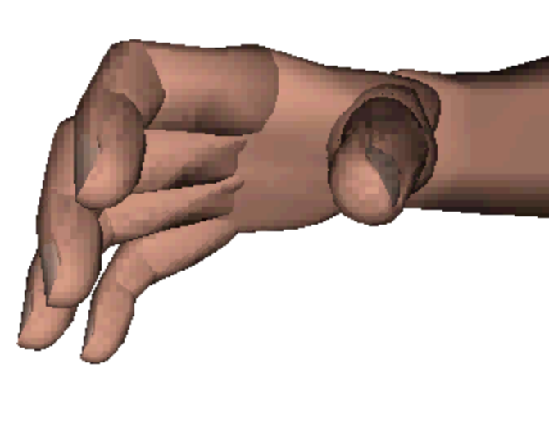
Background
Numerous hand surface geometry models have been developed; few based on large numbers of hand scans. No parametric model is publicly available.
Hand models for populations lack design-level rigor
Hand models in Jack and other ergonomics software lack fidelity in both shape and kinematics and lack local parameterization
Objective:
• develop a parametric, fully articulated hand model with smooth surface interpolation
• use the model to aid in hand measurement
• develop the model into a standalone hand design tool
Jack hand

Slide 3
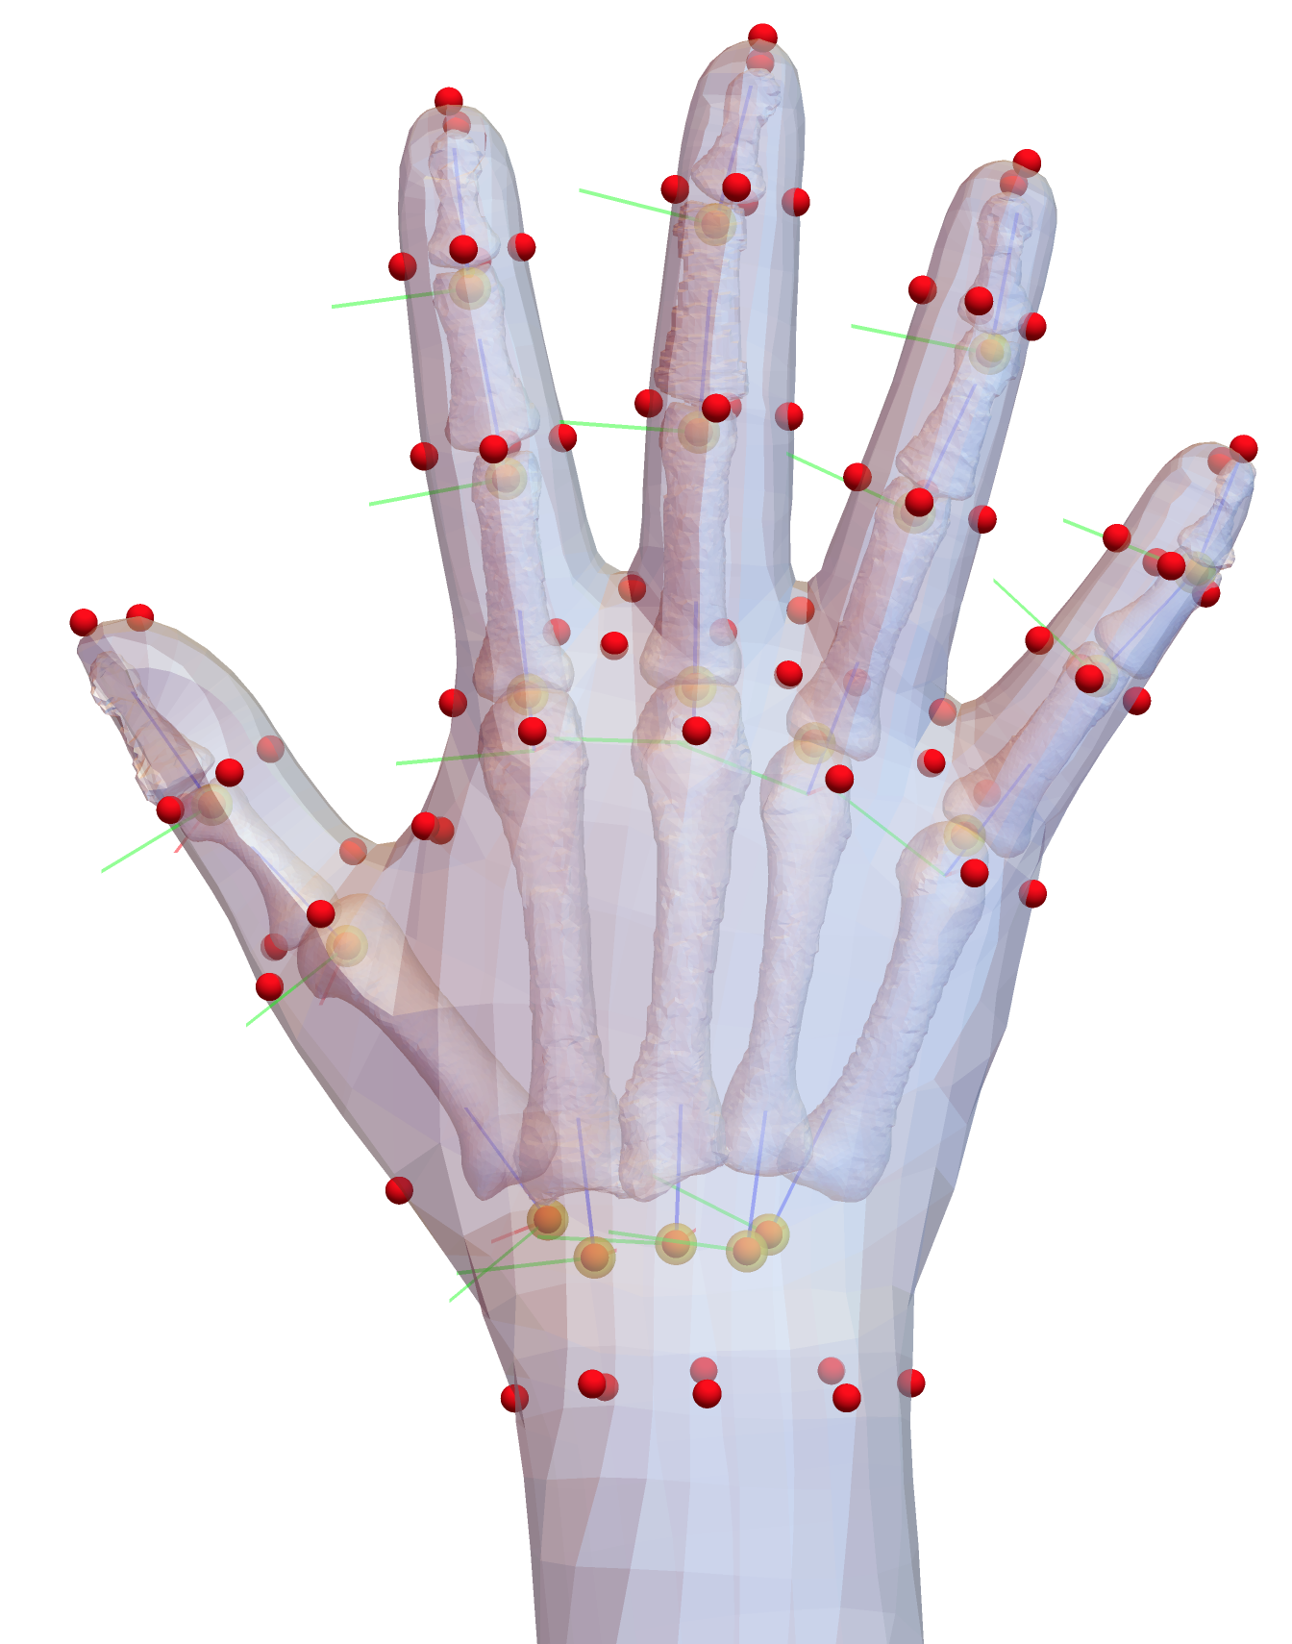
Project Flow (2017)
Rose Figueroa Dissertation
Bone geometry extraction from CT studies (N=35)
Regression Models Predicting Bone Geometry as a Function of Bone Length
Template fitting of 19 bones
Estimation of bone rotation (joint) centers from CT of one subject in multiple postures
Regression Models Predicting Surface Geometry, Landmarks, and Joints as a Function of Body Dimensions
Surface scans of 300 men and women (Canadian Armed Forces)
Template Fitting
Landmarking
Estimate joint centers

Slide 4
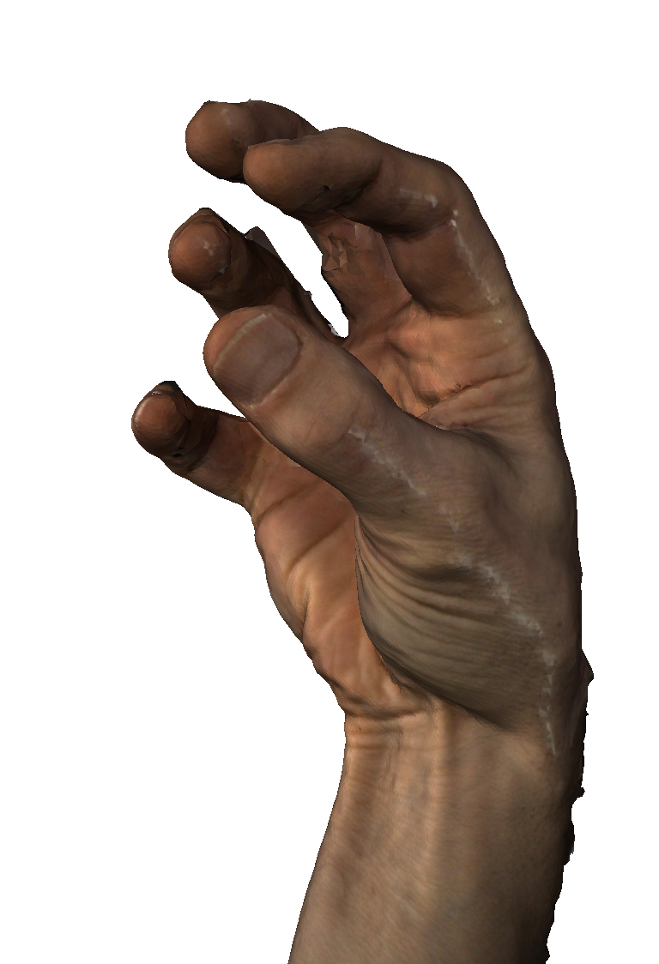
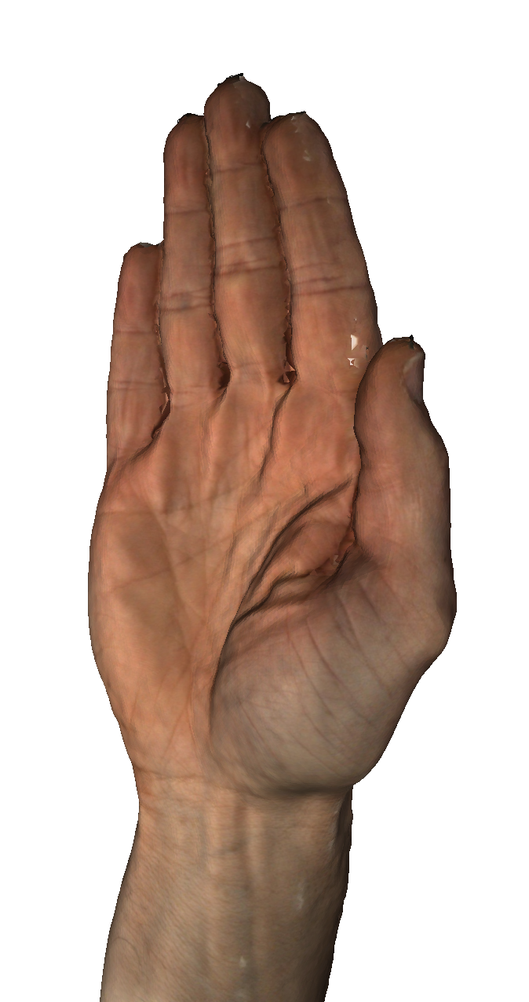
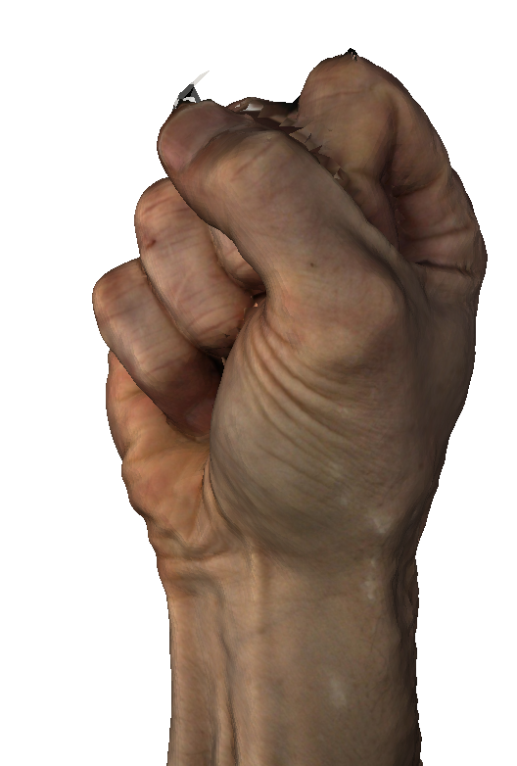
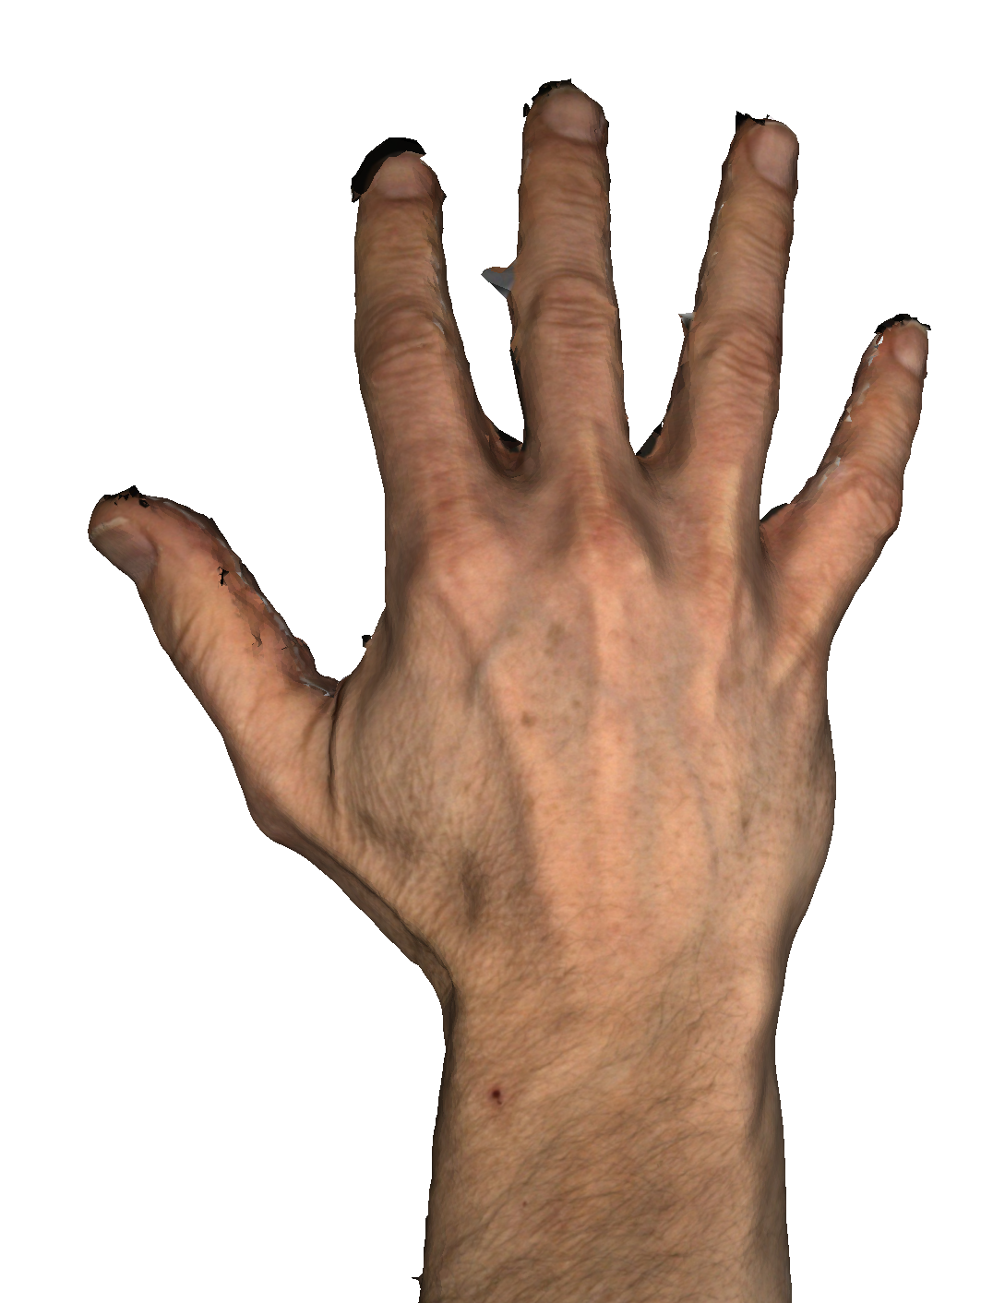
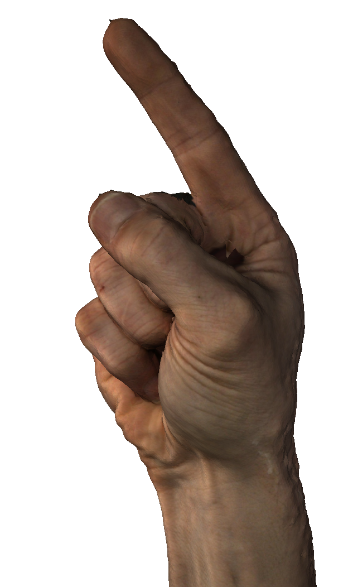
Progress 2022-2023
New 3dMD scanner generates high-quality data
Fully articulated hand model with smooth skin interpolation in Python
Developing methods to automatically fit hand scan data (any pose) with model
Will use new hand data to adapt current parametric model to have high accuracy across a wide range of postures

Slide 5
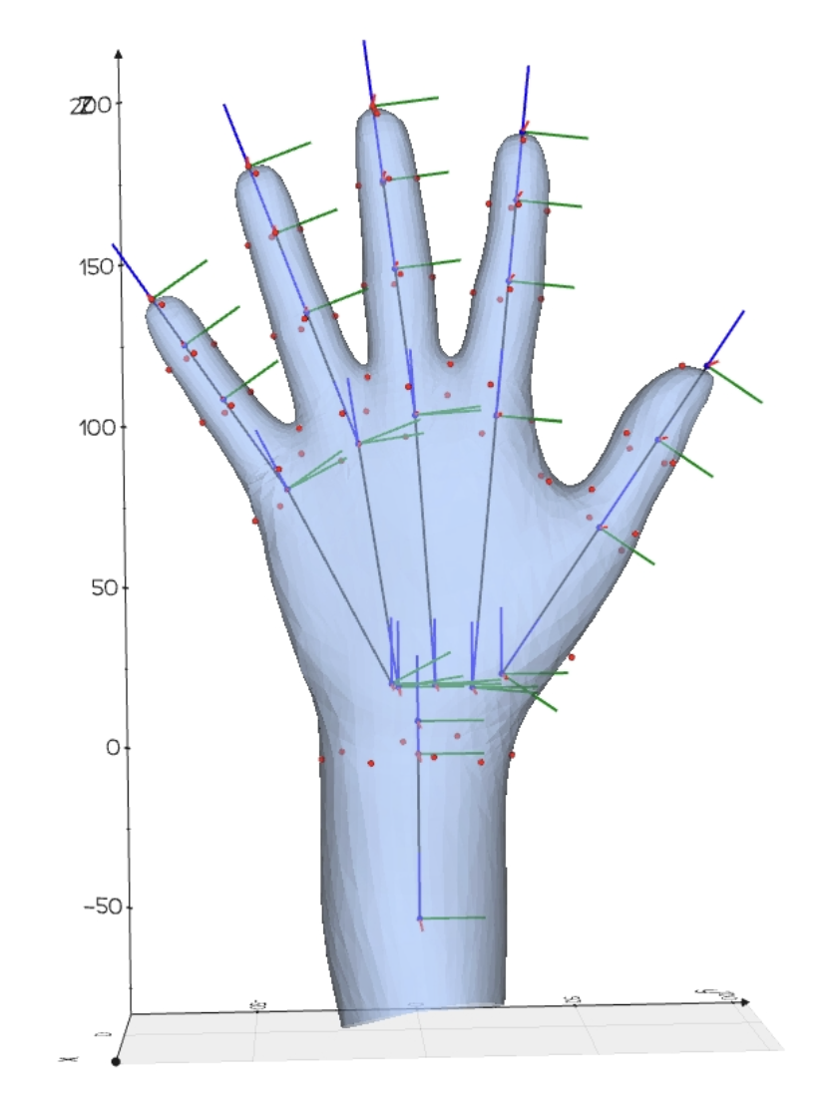
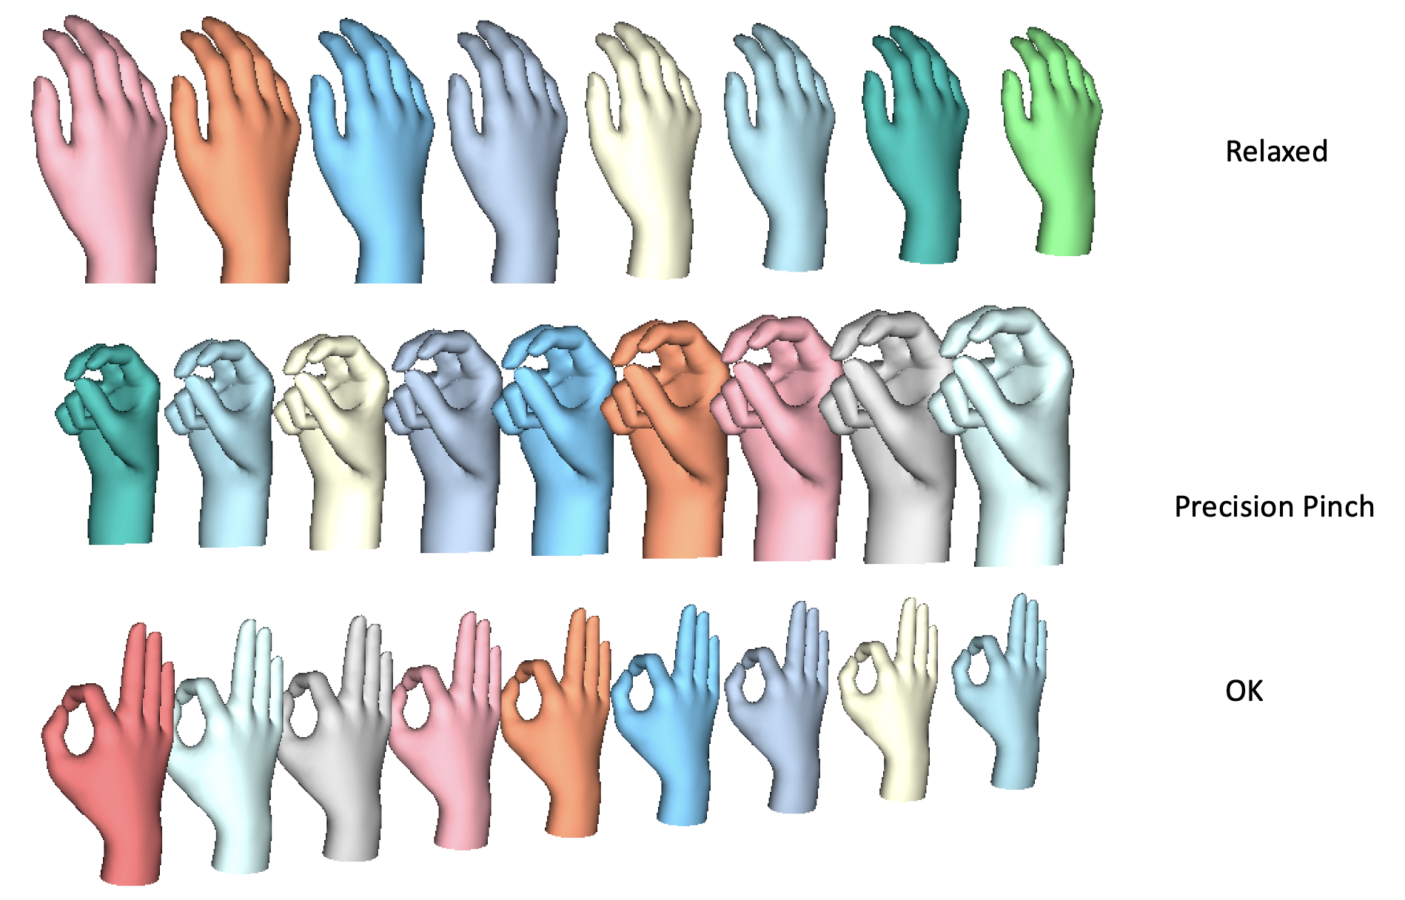
Progress 2022-2023
New 3dMD scanner generates high-quality data
Fully articulated hand model with smooth skin interpolation in Python
Developing methods to automatically fit hand scan data (any pose) with model
Will use new hand data to adapt current parametric model to have high accuracy across a wide range of postures

