Slide 1
Model-based Body Shape/Motion Measurements Using Depth Cameras
Biosciences Group

Slide 2
Inscribed fitting

Slide 3
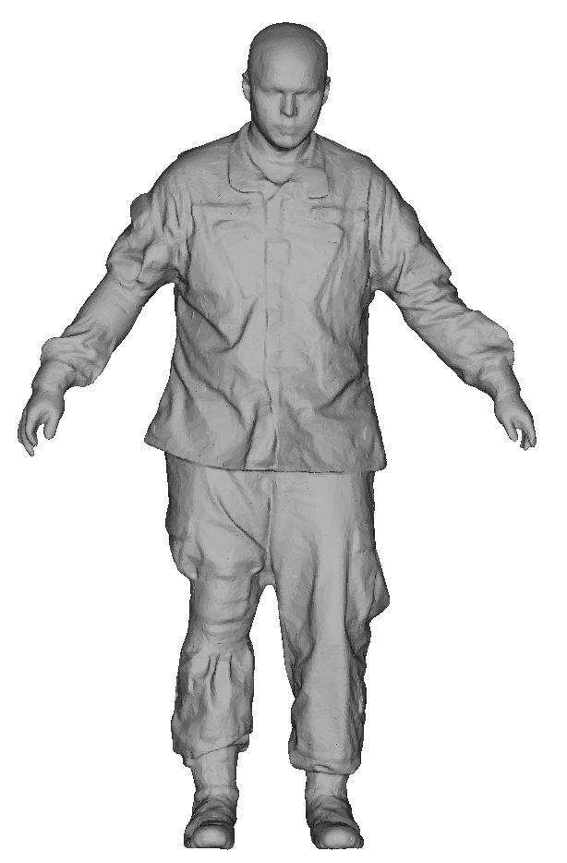
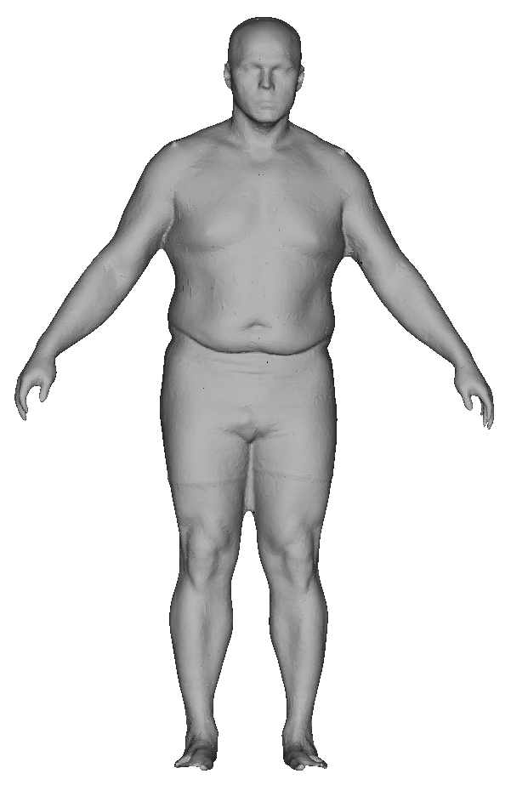

Objectives
“Estimate body shape under clothing or equipment”
  Estimate realistic body shapes of clothing people utilizing a statistical body shape model (SBSM)
  Develop a rapid estimating method requiring low computational resources
Notes:
One of the limitations of our body shape models is that it only takes account for the naked body shape.
So we need to have the subjects naked to apply these models.
So I thought it’ll be very helpful if we have a method to find a naked body shape under clothing. ^
So these are the main objectives of this study:

Slide 4
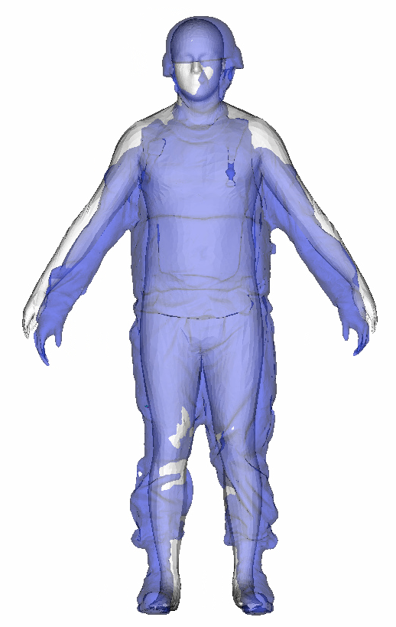
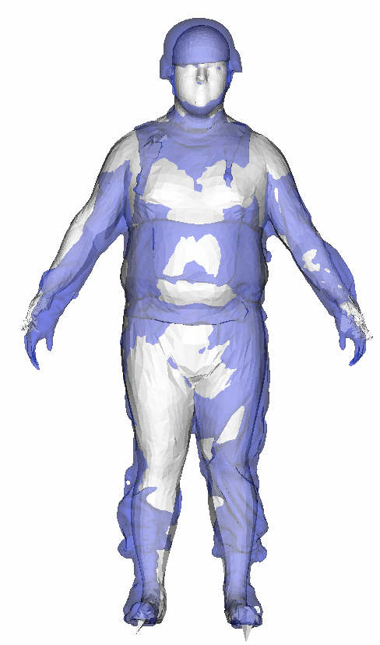
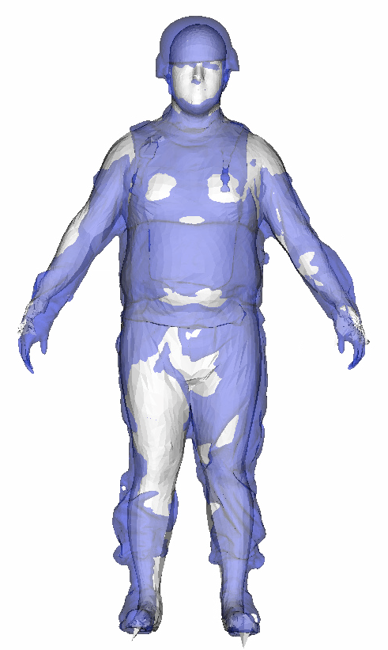
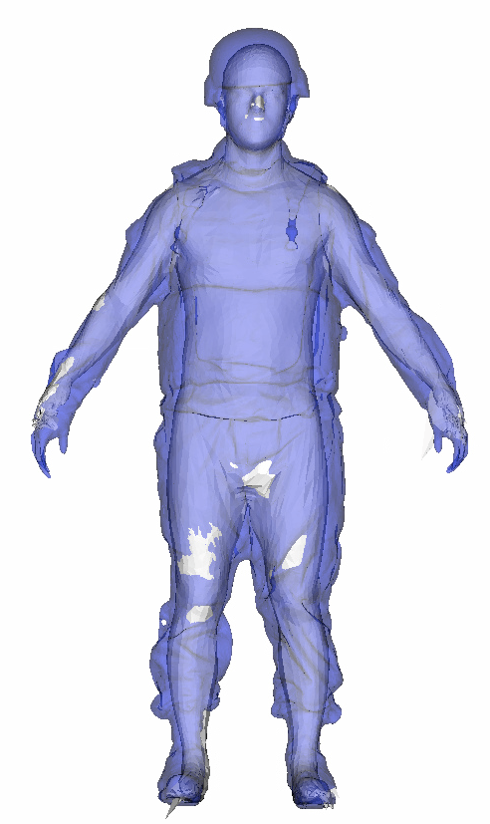
Inscribed Fitting
Fitting Process: Alignment > Initial fitting > Pushing outside vertices iteratively
(a) alignment
(b) Initial fitting
(c) 1st iteration
(d) 10th iteration
(c) 1st iteration
(d) 10th iteration
(c) 1st iteration
(d) 10th iteration
(c) 1st iteration
(d) 10th iteration
(c) 1st iteration
(d) 10th iteration
Notes:
This shows the overall fitting process. White figure is the body shape model, and the blue is a target scan.
First, we need to align the model to scan, then the model is fit to the scan using the fitting method.
Then the outside vertices which are shown in white parts in the second figure are pushed into the scan surface, and the third figure is the result of the first iteration, and by doing some iterations, we can estimate the body shape under the clothing.

Slide 5
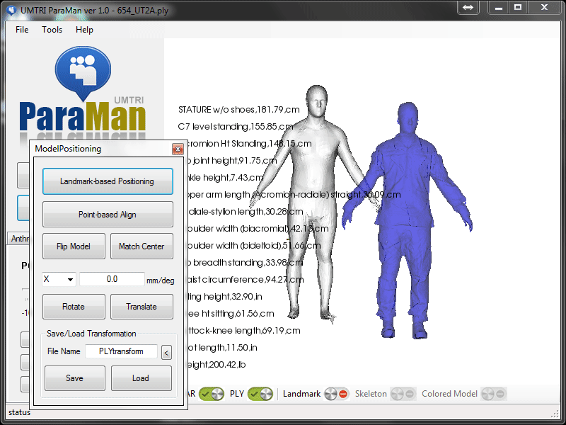
Software
Demonstration
Alignment Model
Initial Fitting
Inscribed Fitting

Slide 6
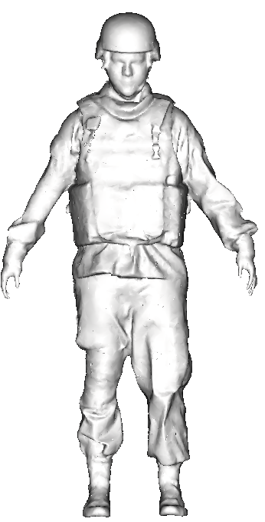
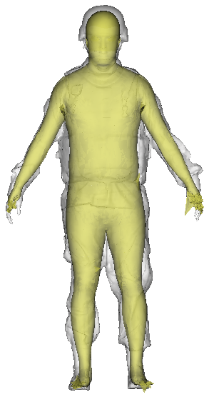
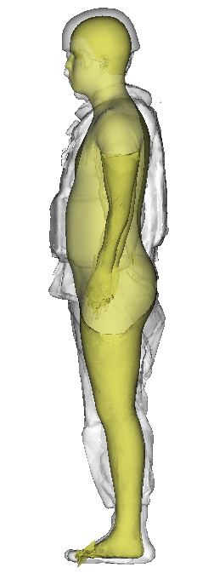
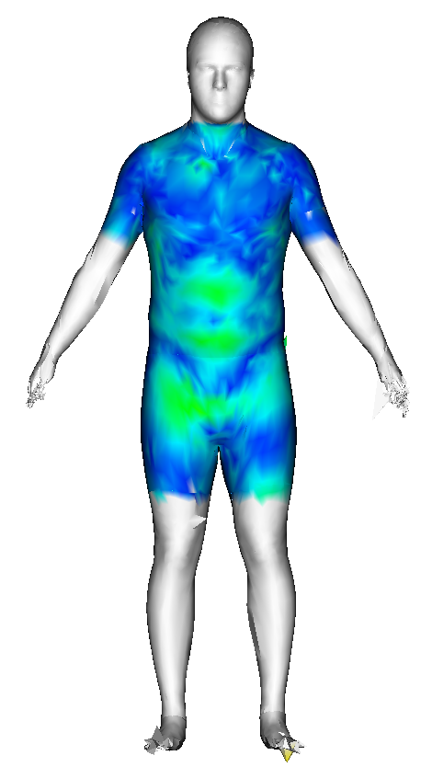
Fitting Result
PPE level: mean 11.0 mm, 95th %tile 15.0 mm, RMSE 11.5 mm
50 mm
0 mm

Slide 7
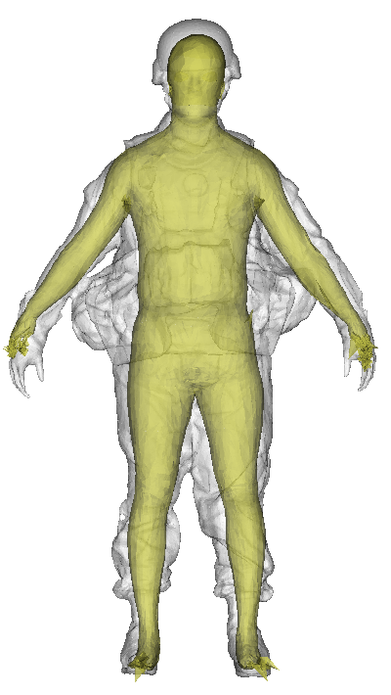
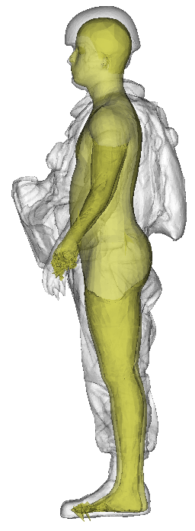
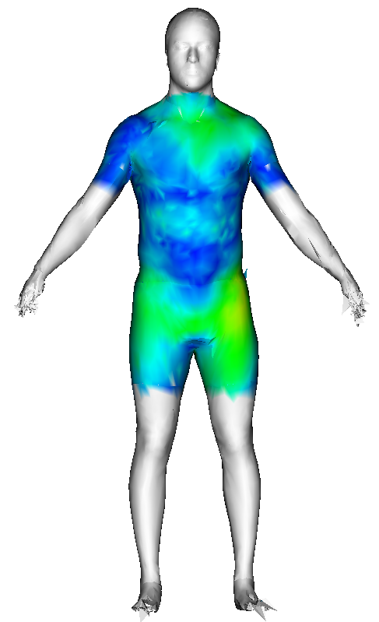
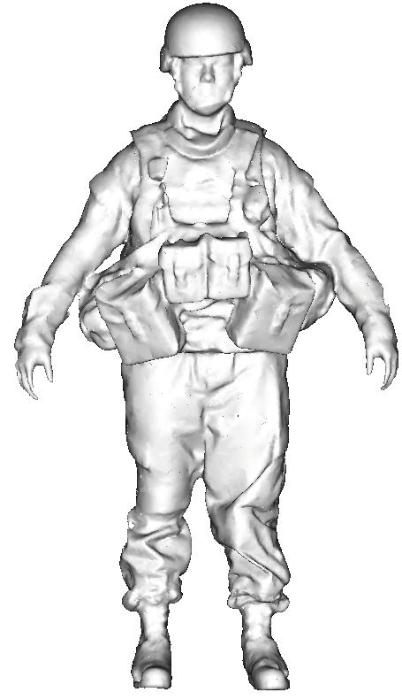
Fitting Result
ENC level: mean 11.6 mm, 95th %tile 16.5 mm, RMSE 12.0 mm
50 mm
0 mm

Slide 8
Worker Posture Monitoring

Slide 9
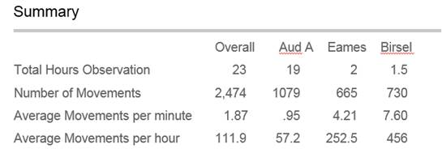
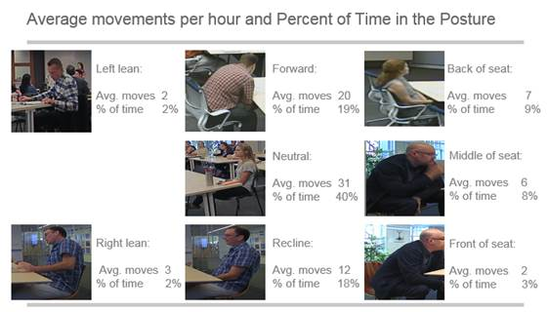
Background
Requested to replace a manual posture coding procedure
  An office furniture company conducted a series of studies analyzing workers’ postures
  Videotaped worker postures and manually coded posture changes over time while watching the videos
  Time consuming, not consistent across raters, and hard to quantify postures (e.g. angles)
Fig. A sample of report of manual posture analysis

Slide 10
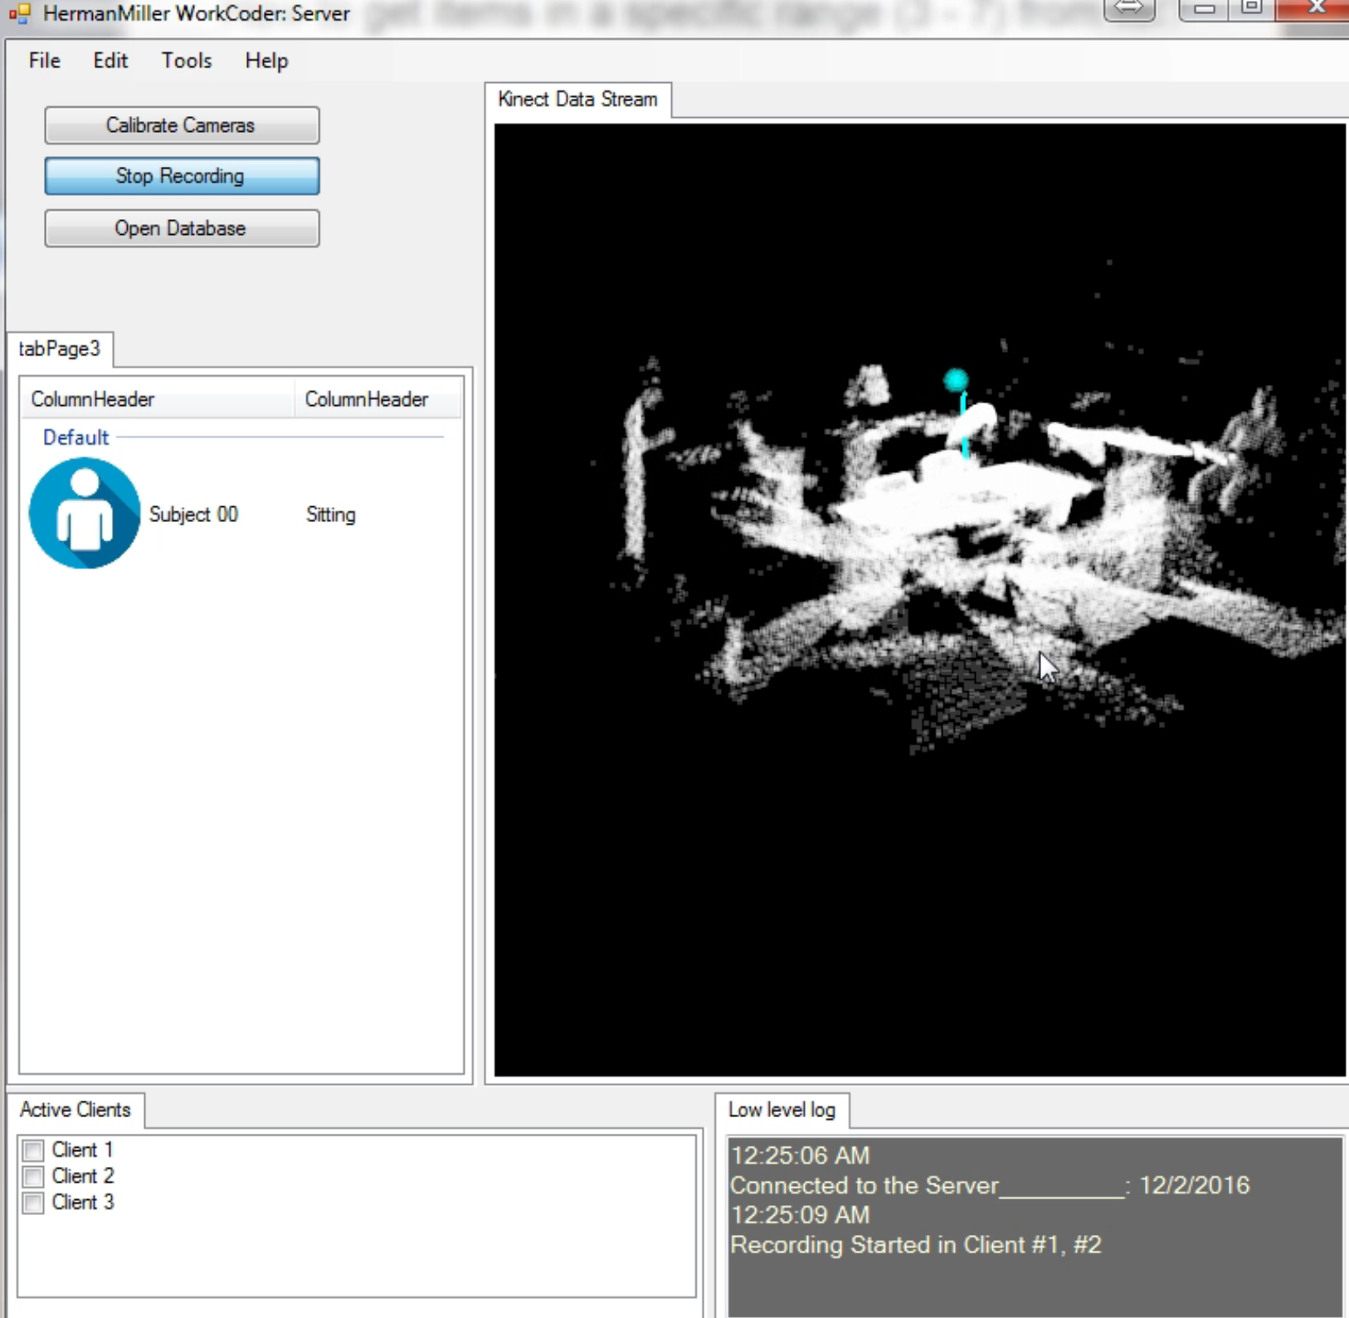



Server Program GUI
Visualization Panel
Participants Status
Visualize Kinect skeleton data streamed from the clients in real time. Depth data of an initial frame is also visualized.
Show participants IDs and postures being tracked
Standing
Walking
Sitting/Leaning
Active Client List
Log Panel
Show the currently active client lists connected to the server
Show the current status of system and error

Slide 11
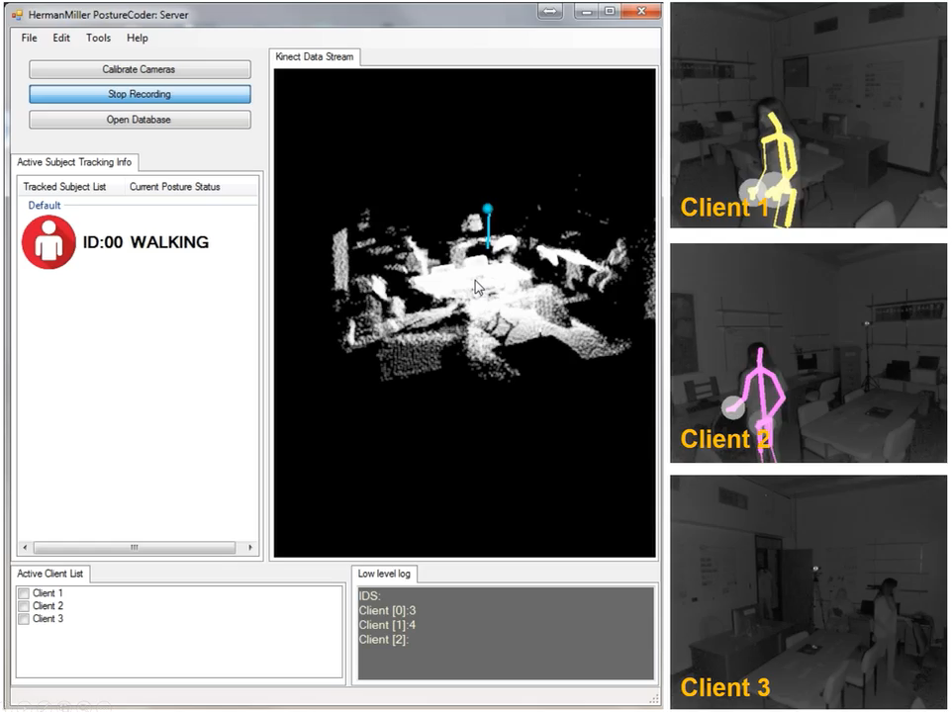
System Demo

Slide 12
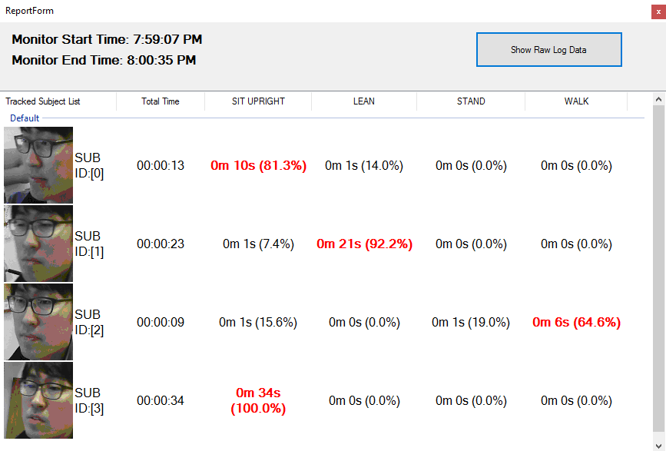
Reporting Module
Report analyzed posture data
  ID and tracked face images
  Total recorded durations
  Sum of times and percentages of each posture
  Raw head and pelvis data

Slide 13
Conclusion
The results showed that the system can track multiple people and recognize worker’s postures and transitions
  Using multiple Kinect sensors was effective to track multiple people especially when they are occluded by the others
Major limitation is that the system performance and accuracy depend on the Kinect data quality
Future works:
  Automatic participant identification
  Detect worker postures using machine learning technique

Slide 14
Markerless Motion CApture

Slide 15
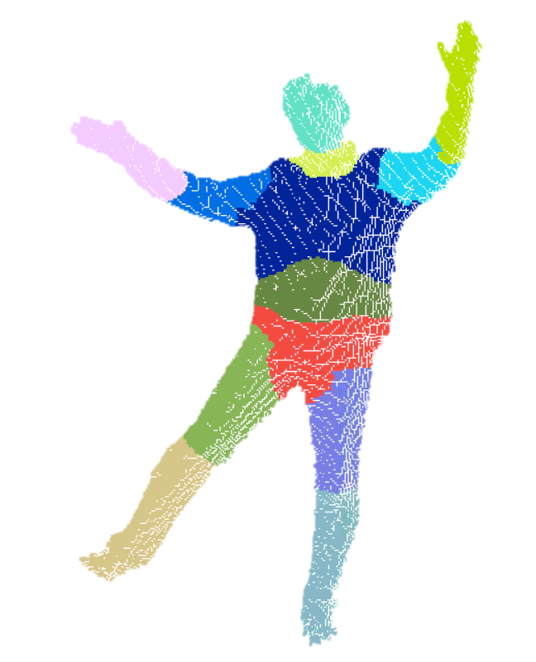
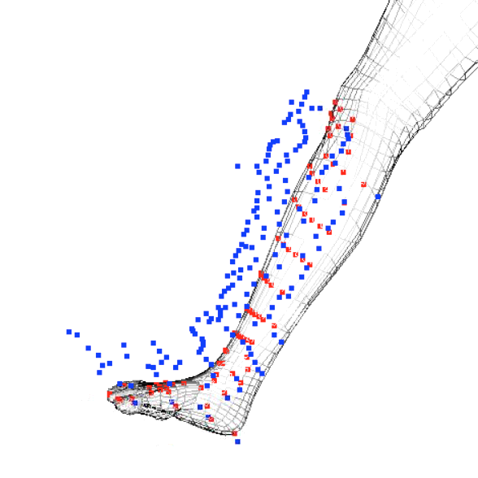
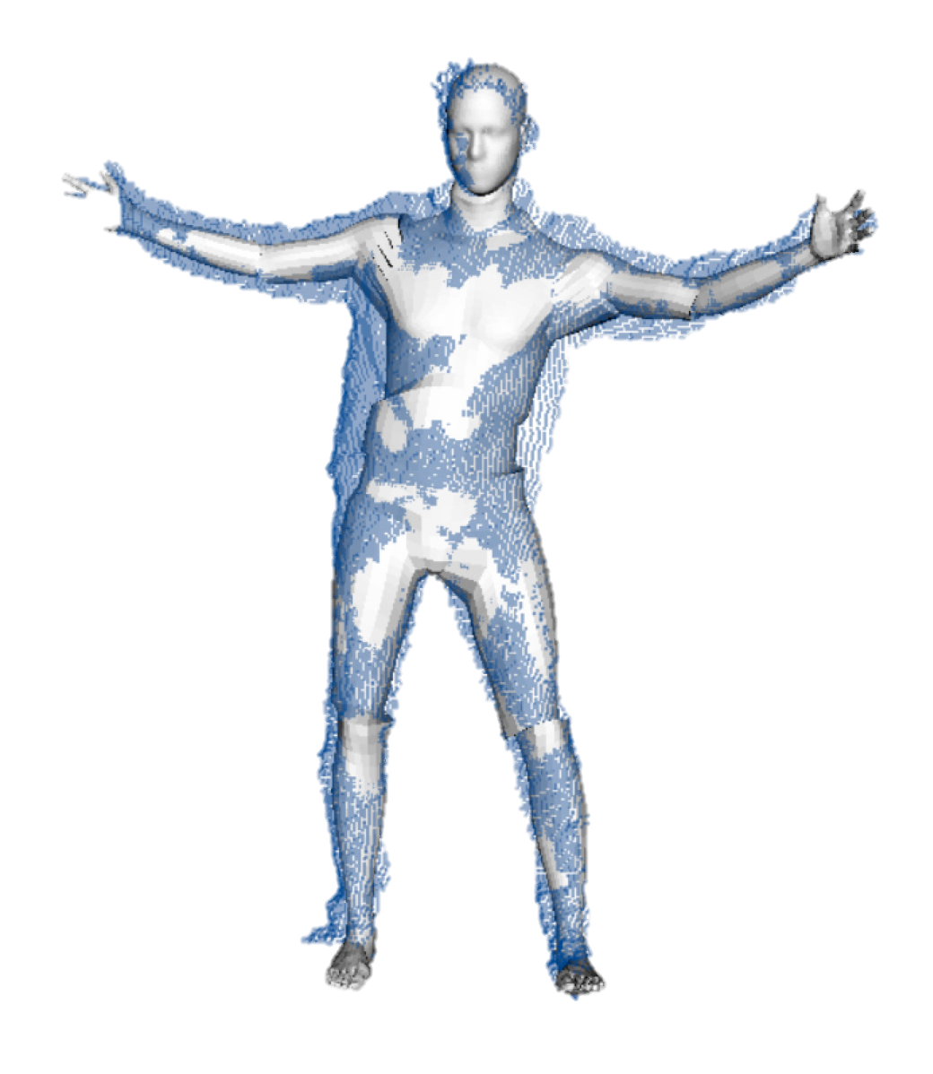
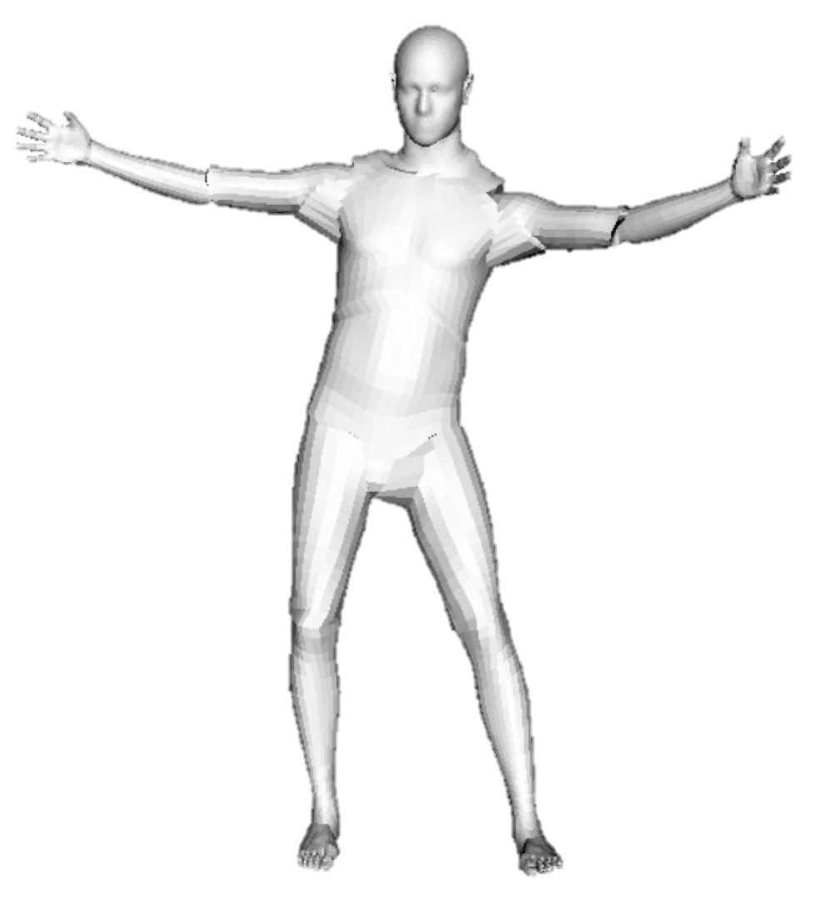
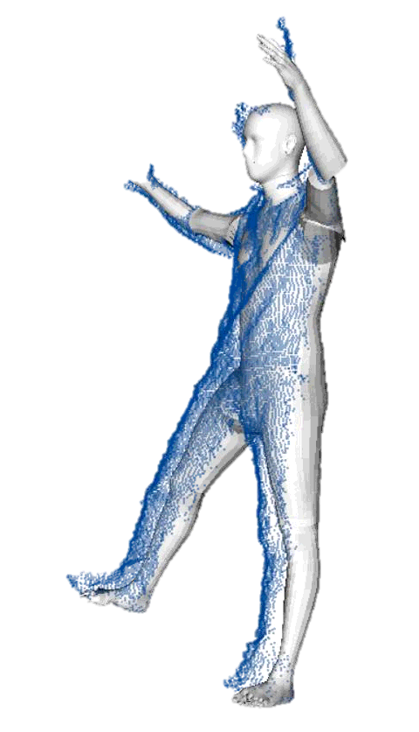
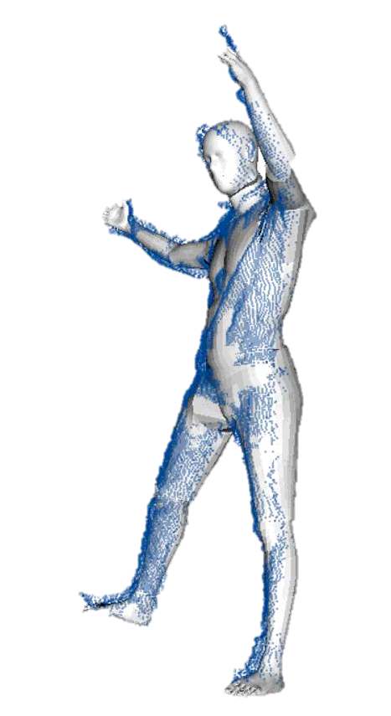
Model Fitting using Articulated ICP
Flowchart of the fitting algorithm
1. Find correspondences between depth points and each body segment
iteration
2. Find a transformation matrix to align each segment to depth points
4. Apply joint constraints
T_{i}
3. Apply the found transformations to each body segment

Slide 16
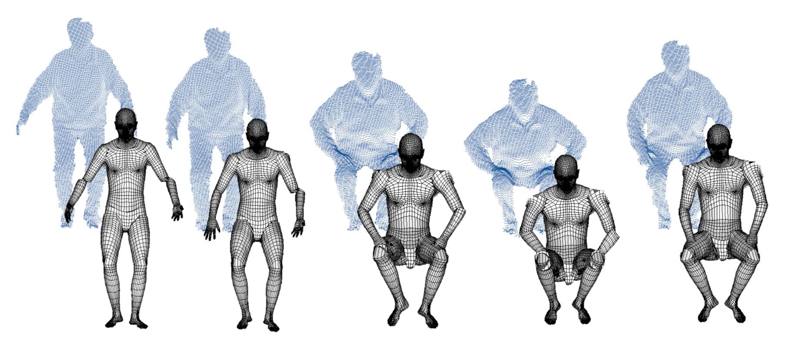
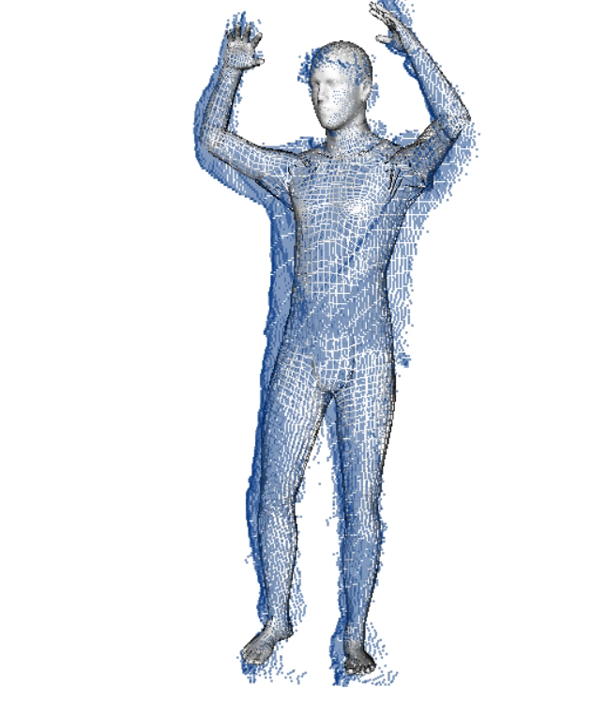
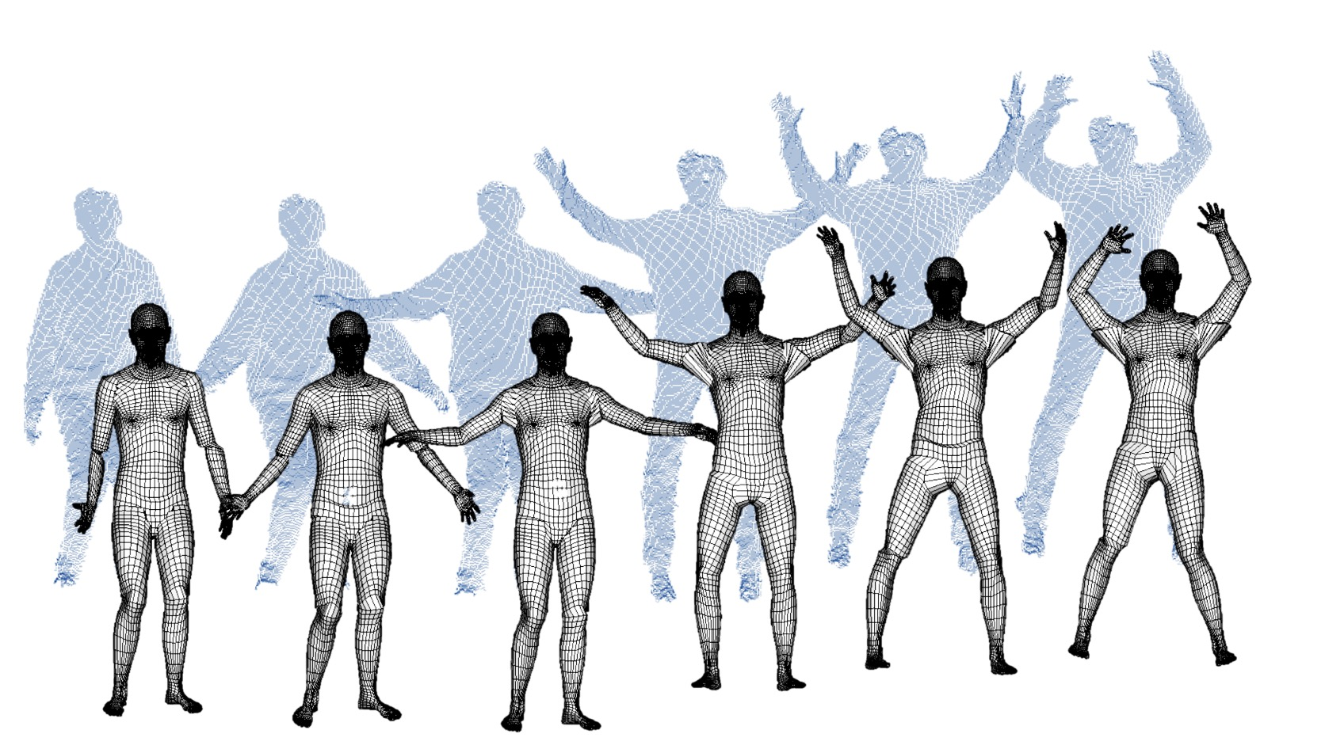
Results

Slide 17
Occupant Dynamics Tracking

Slide 18
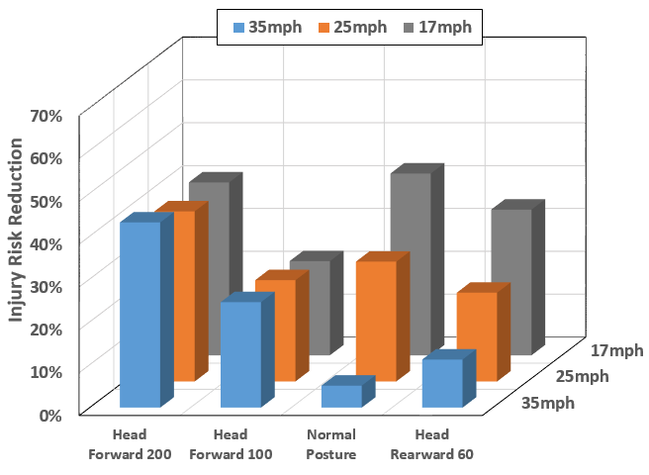
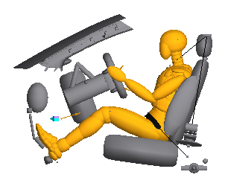
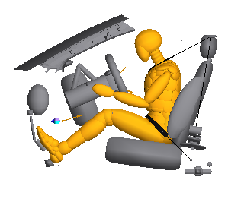
Background: Integrated Safety
Up to 48% of injury risk reduction can be achieved if the passive system is optimized to adapt pre-crash postures caused by active safety system (Hu, et al. 2015)
Normal Pre-crash posture
Head forward 200 mm
Baseline ATD Simulations with different postures
US-NCAP condition
Notes:
Active safety system, like crash avoidance features are getting more mainstream for the modern vehicles fleet,
but this system can change the pre-crash occupant postures to out of position.
And one issue is that the almost all the passive safety systems were designed and optimized based on ATD with the standard sitting postures.
If the occupant is out-of-position before a crash, the current passive system will not be as effective.
In our previous study, we simulated more than 4000 cases and optimize the passive SS with respect to difference precrash postures,
Observed that the injury risk can be reduced up to 48% if the passive SS is optimized to adapt these postures caused by active SSs.
Meaning that if we understand occupant behaviors relative to the vehicle movements, the passive SS can be further optimized to better protect the people.

Slide 19
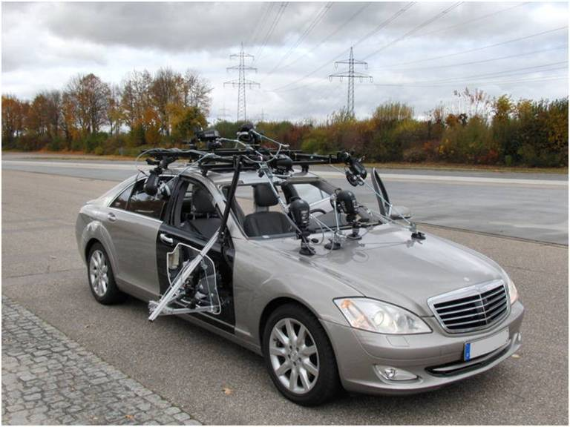
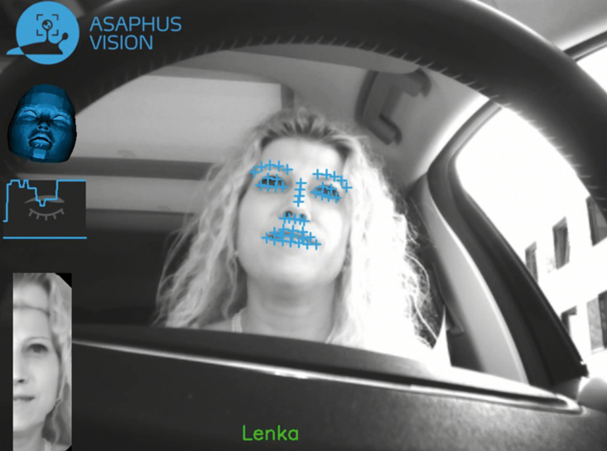
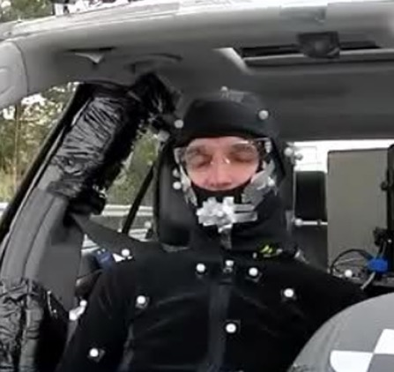
Previous Studies: In Vehicle Head Tracking
Marker-based head tracking: + Suitable to obtain accurate 3D locations
- Requires excessive hardware to track markers
Image-based head tracking: + Can capture naturalistic occupant behaviors - Hard to measure accurate 3D locations
Images from VIRTUAL VEHICLE (http://www.v2c2.at)
Image-based head tracking Ivantysynova et al. 2015
Notes:
A traditional approach to capture occupant behaviors is to use a marker-based motion capture system. It’s sutiable ….
The alternative approach is image-based head tracking tech. Due to the recent advances in computer vision techniques and machine learning algorithms, many have attemted to track the head and face. This is quite effective to capture naturalistic behavior of the occupant, especially for tracking the orientation or face getures. But

Slide 20
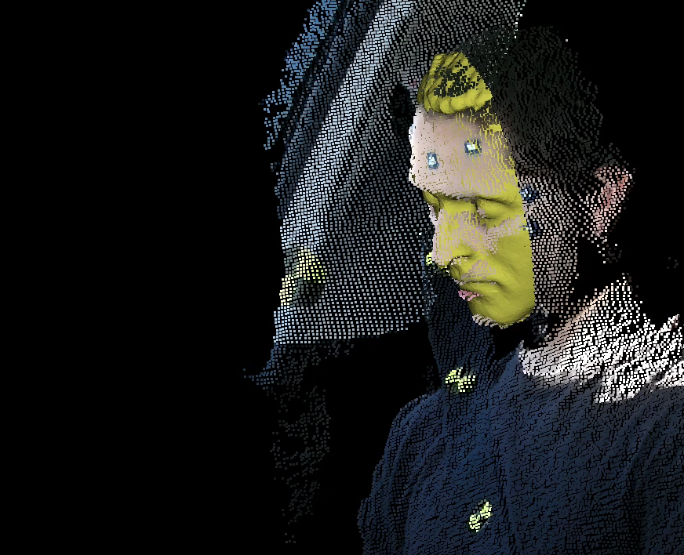
Model-based Head Tracking
Select the depth points near to a 3D head scan surface using kd-tree
Fit the head scan to the selected points using ICP and store
Update depth data for the next frame
Update the fitted head scan based on transformations between previous frames to predict the initial guess for the next frame
Go to step 1.
Notes:
Once we got the depth points processed, we tracked the head by fitting a 3d head scan to each depth frames.
Using 3d Head model is important not only for tracking the entire head movements, but also for measuring accurate orientations and locations of predefined landmarks like eye center, or nose tip.
Let me briefly explain how we track the head.

Slide 21
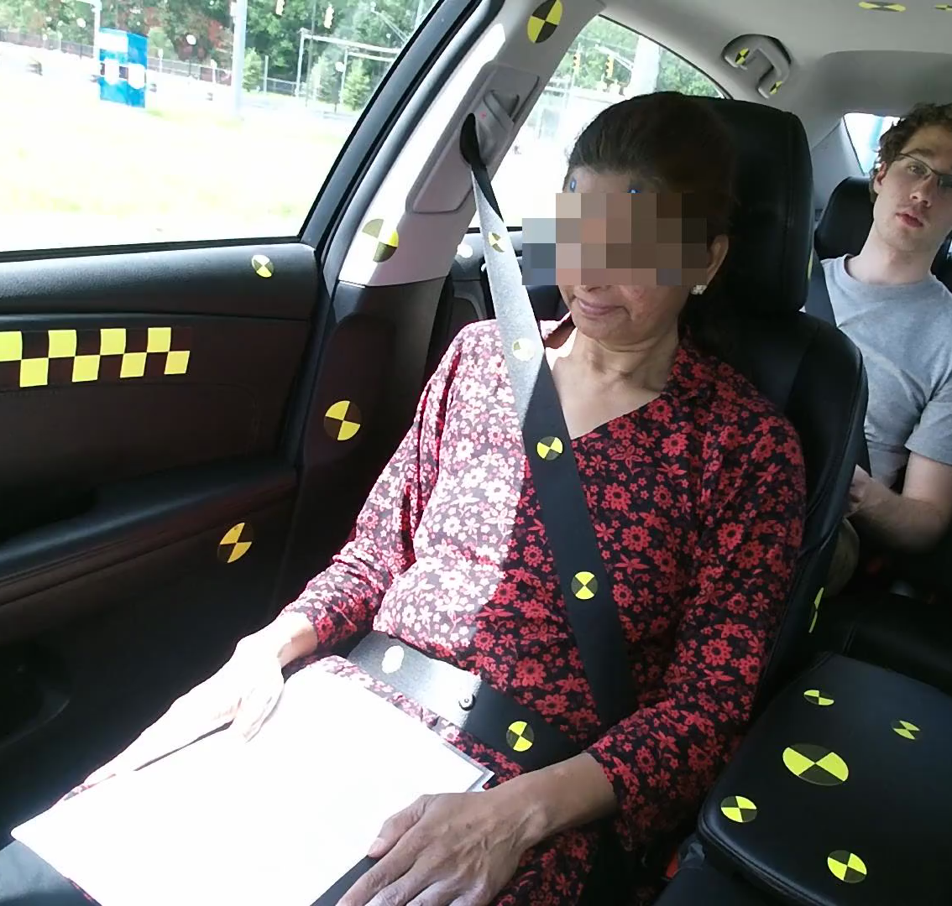
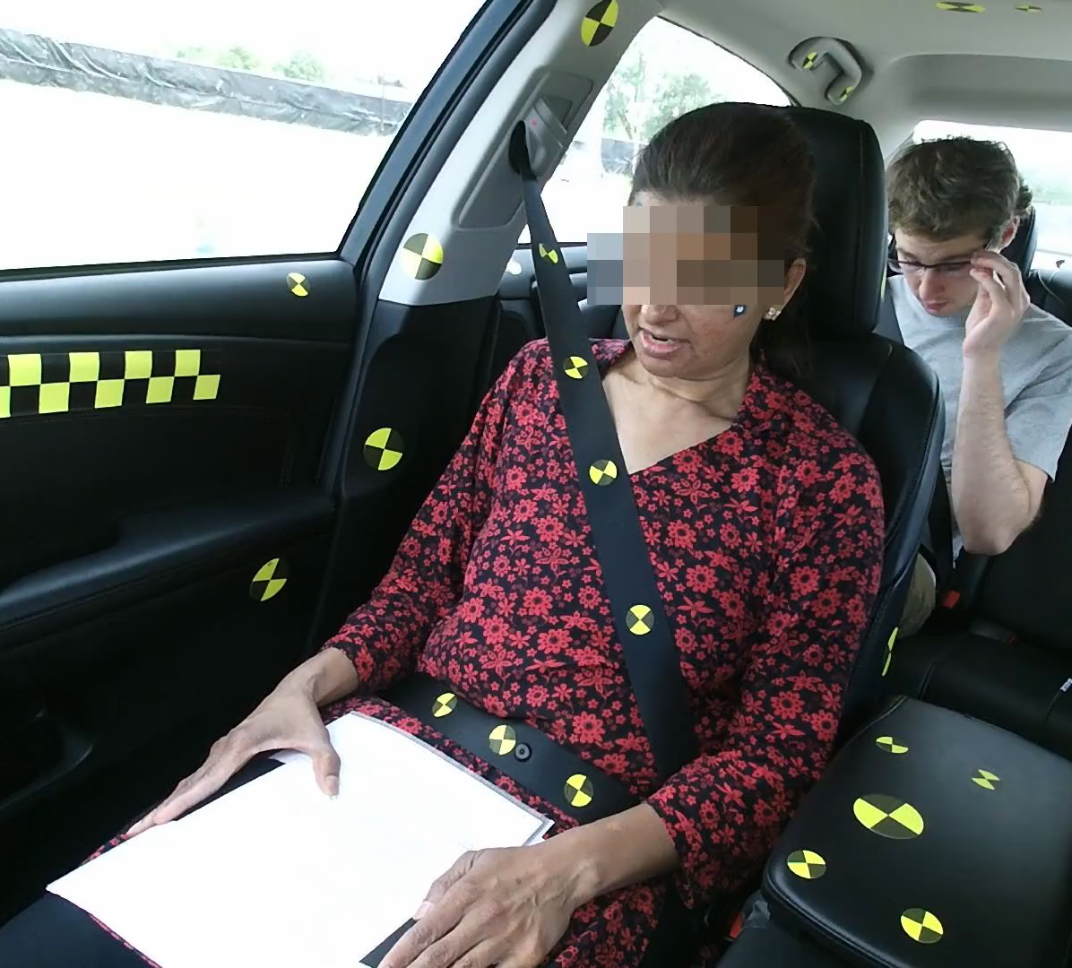
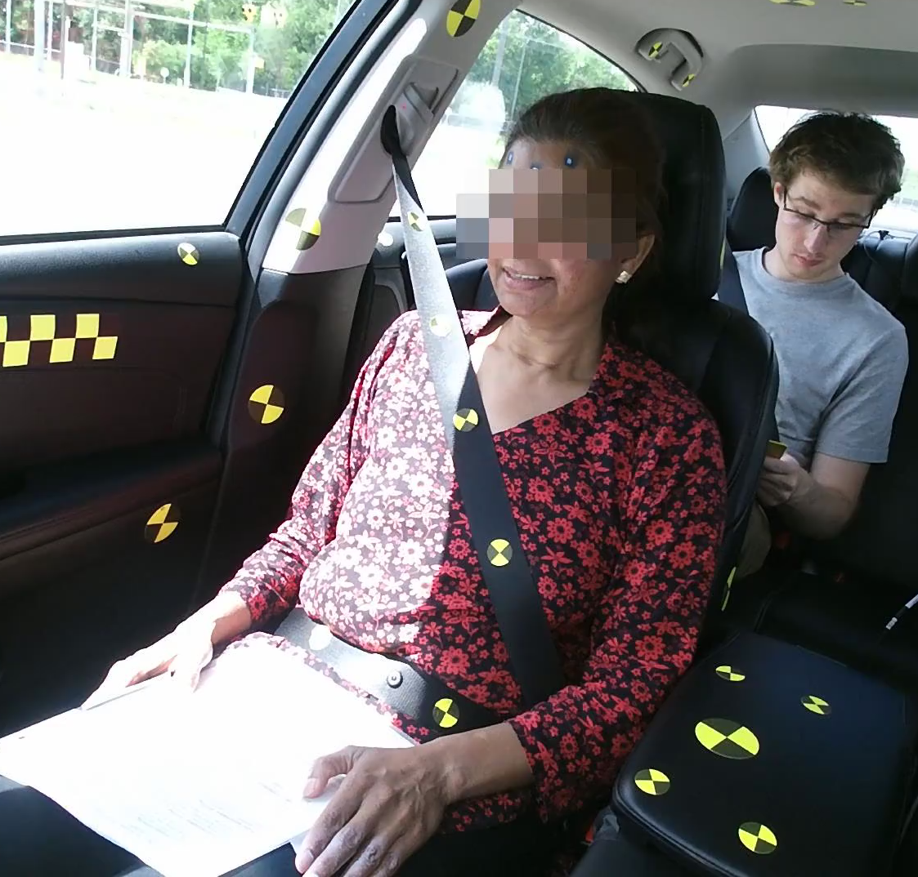
Data Collection
- A total of 348 trials (4 events per subject) were performed
- Subjects were asked to answer questions during the events
Hard brake
Turn and Brake
Lane Change
Notes:
We wanted to gather naturalistic and unaware responses, so we had a distraction tactic, which is asking to the subject to answer some questions.
She didn’t know oncoming event and what will happen to her..

Slide 22
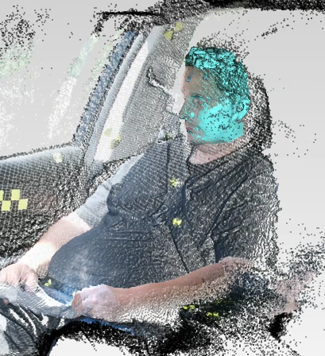
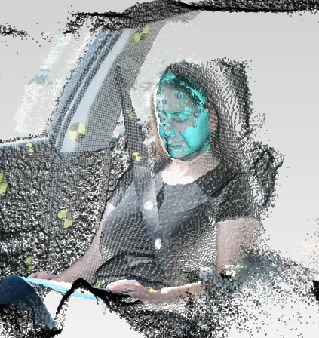
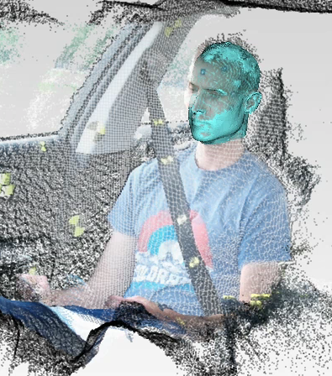
Tracking Result Samples
BRAKE
TURNING
LANE CHANGING
Notes:
- Can see how well the developed method works well for capturing the head movement during the events.

Slide 23
Conclusion
We investigated the utility of a single ToF depth camera for the in-vehicle markerless tracking of an occupant’s head during abrupt maneuvers.
We demonstrated that fitting 3D head scan to the depth data can provide the accurate head location and orientation tracking over time.
Future Works
  Data Analysis (Maximum excursions & relationships with potential predictors, Head location distributions, Torso/head displacement for braking)
  Build a statistical head dynamics model
Notes:
This is also the first large-scale study to quantify the effects of multiple trials on excursions, beginning from an “unaware” baseline.

Slide 24
Thank you
CONTACTS
B-K. Daniel Park, PhD (keonpark@umich.edu)
Matthew P. Reed, PhD (mreed@umich.edu)

