Slide 1
Parametric Hand Modeling:
Progress Update
Matt Reed
Research Professor
mreed@umich.edu
http://mreed.umtri.umich.edu/
University of Michigan
August 14, 2017

Slide 2
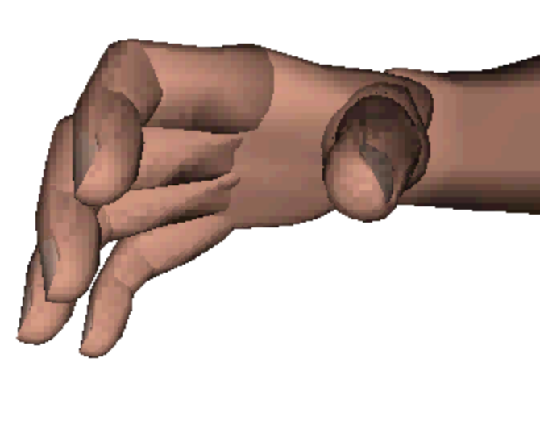
Background
Numerous hand surface geometry models have been developed; few based on large numbers of hand scans. No parametric model is publicly available.
Previous models of skeletal geometry were based on few subjects and the most capable one used MRI rather than CT, which produces less accurate bone shape estimates.
Kinematic models have been based mainly on surface rather than bone measurements.
Hand models in Jack and other ergonomics software lack fidelity in both shape and kinematics.
Jack hand

Slide 3
Objective
Develop a parametric* hand surface and skeleton model suitable for a wide range of spatial and biomechanical analyses
* By ”parametric” we mean that we can generate predicted hand geometry for arbitrary input variables, such as sex, overall body size, age, or hand dimensions.

Slide 4
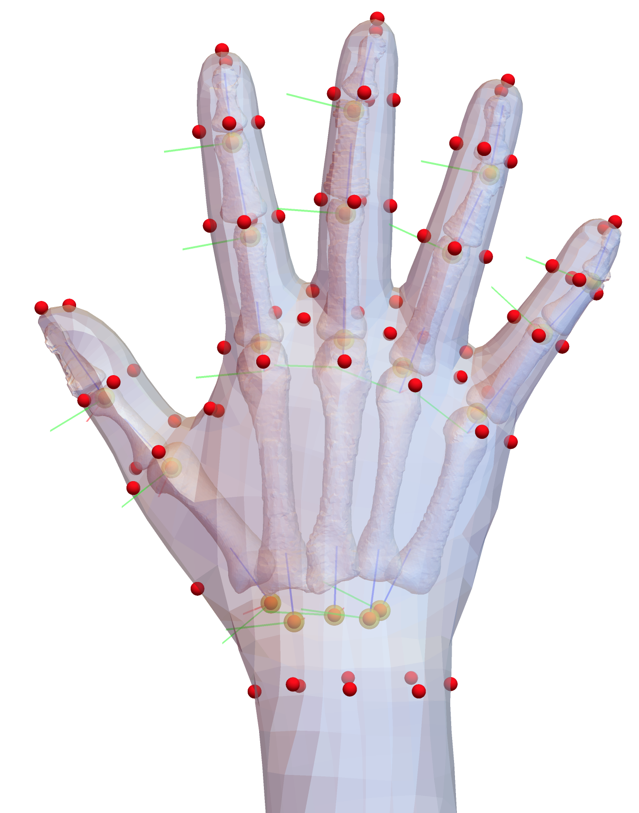
Project Flow
Rose Figueroa Dissertation
Bone geometry extraction from CT studies (N=35)
Regression Models Predicting Bone Geometry as a Function of Bone Length
Template fitting of 19 bones
Estimation of bone rotation (joint) centers from CT of one subject in multiple postures
Regression Models Predicting Surface Geometry, Landmarks, and Joints as a Function of Body Dimensions
Surface scans of 300 men and women (Canadian Armed Forces)
Template Fitting
Landmarking
Estimate joint centers

Slide 5
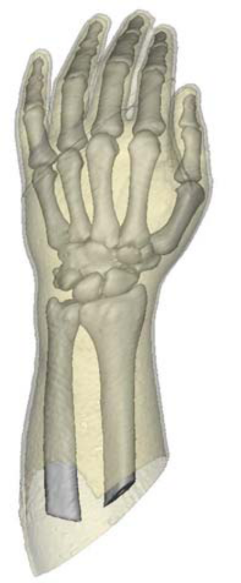
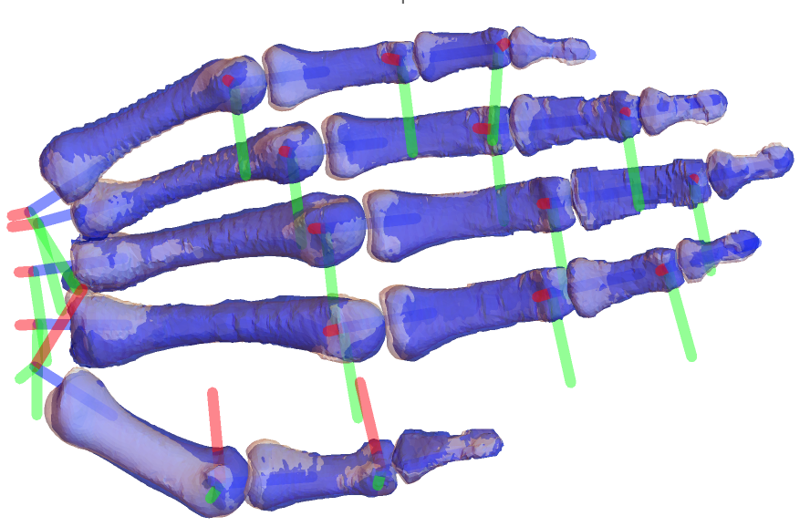
Bone Data
Figueroa 2017
Individual bones extracted from CT studies
Each bone was fit using an template with 500 or 1000 vertices
Local bone coordinate systems were constructed based on joint center information
Regression predictions based on segment length

Slide 6
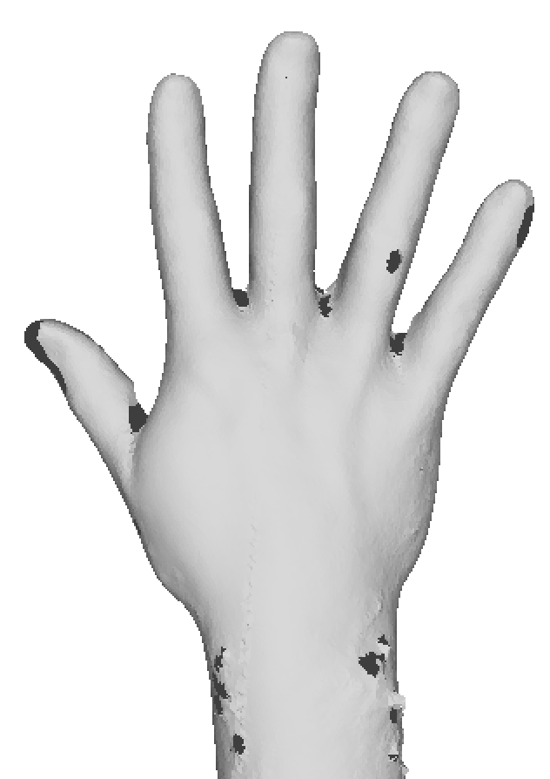
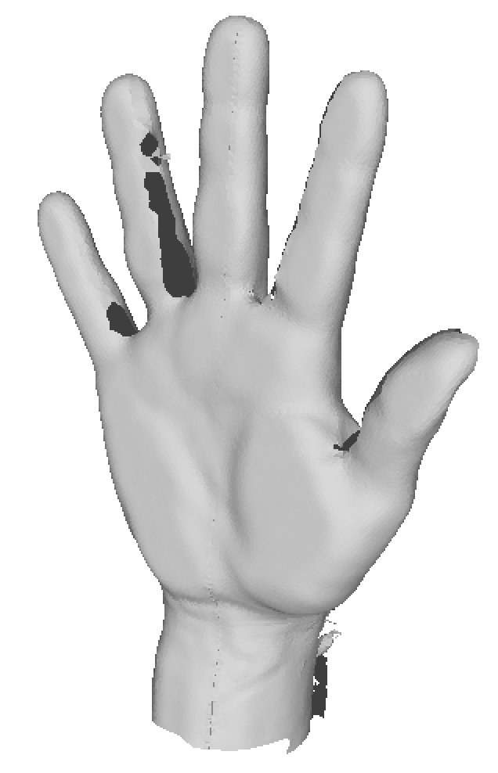
Hand Surface Data
Canadian Armed Forces Survey
Scanned flat hand using dedicated hand scanner
~1200 scans reviewed for this project
150 men and 150 women selected for analysis based on scan quality

Slide 7
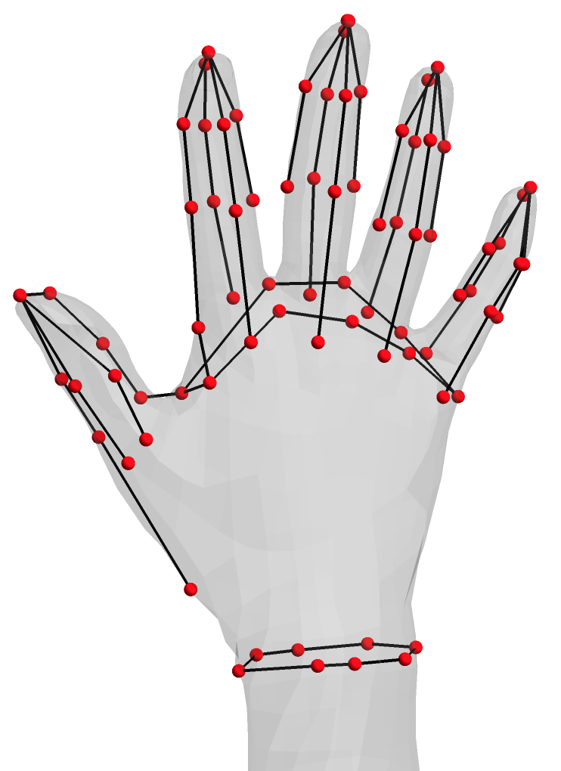
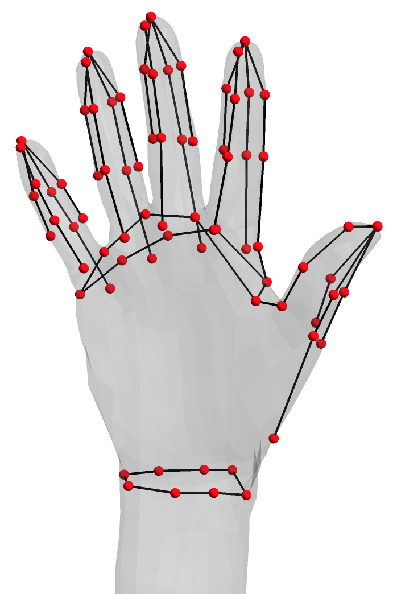
Hand Surface Landmarking
78 landmarks defined based on anatomical features
Includes landmarks gathered on CT scans
Landmarks located on scans using Meshlab software

Slide 8
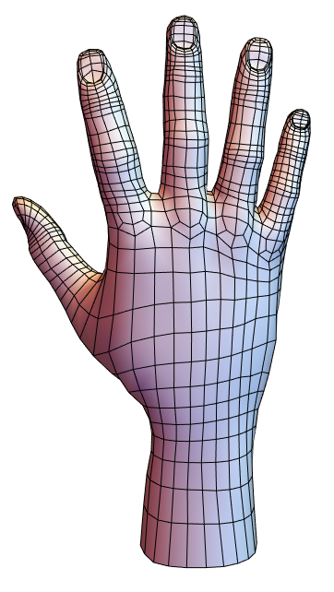
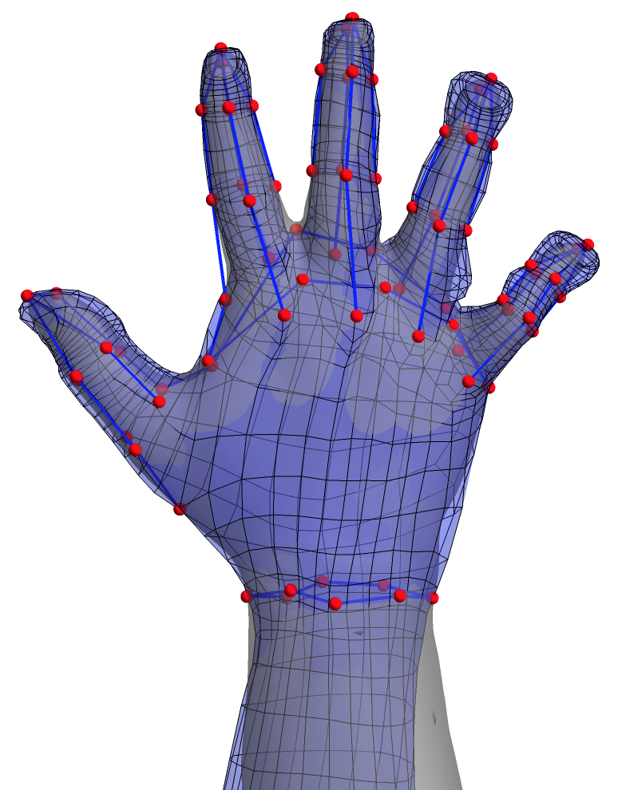
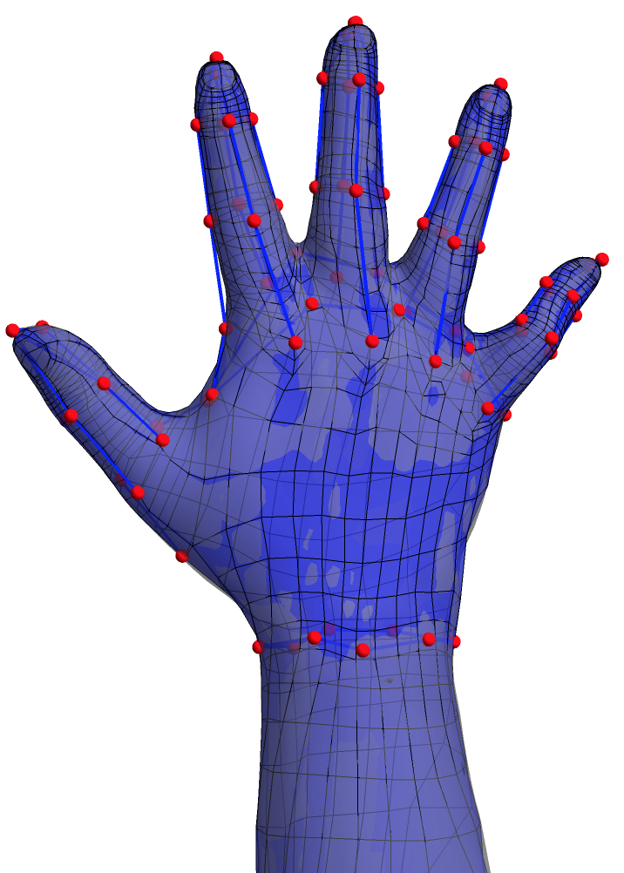
Hand Surface Template Fitting
Template Hand Surface from UMTRI’s BioHuman Mesh
Initial Morph to Target Using Only Landmarks
Final Morph Using Implicit Surface Fit

Slide 9
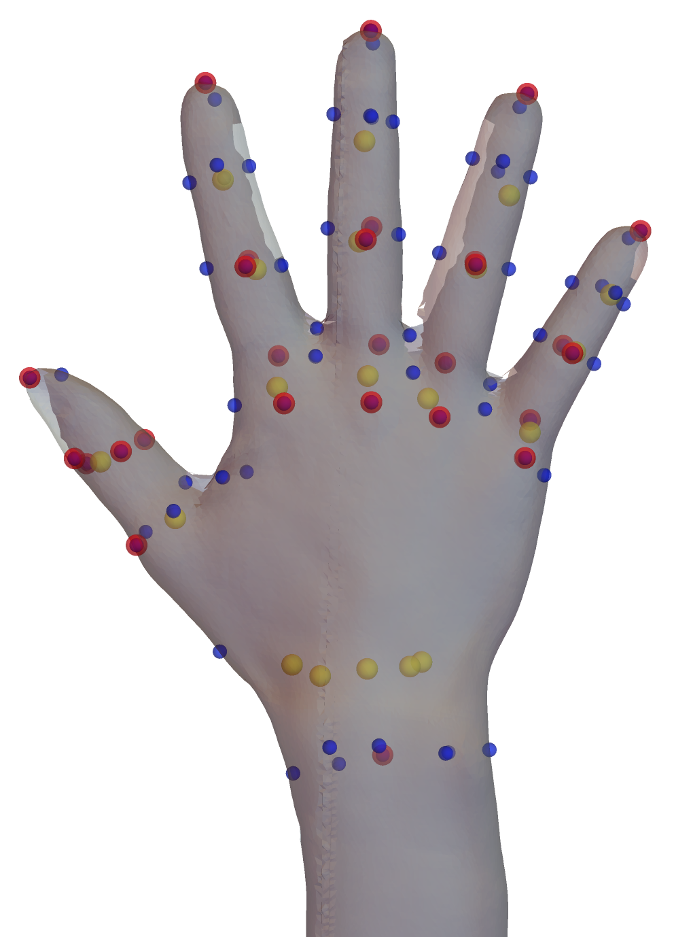
Joint Estimates for Hand Surface Data
Compute mean landmark and joint locations in CT data
Compute a non-rigid morphing function to move the mean landmarks to the measured landmarks on a scan
Apply the morphing function to the mean joints
Joints in Yellow
CT skin points in Red
Surface landmarks in Blue

Slide 10
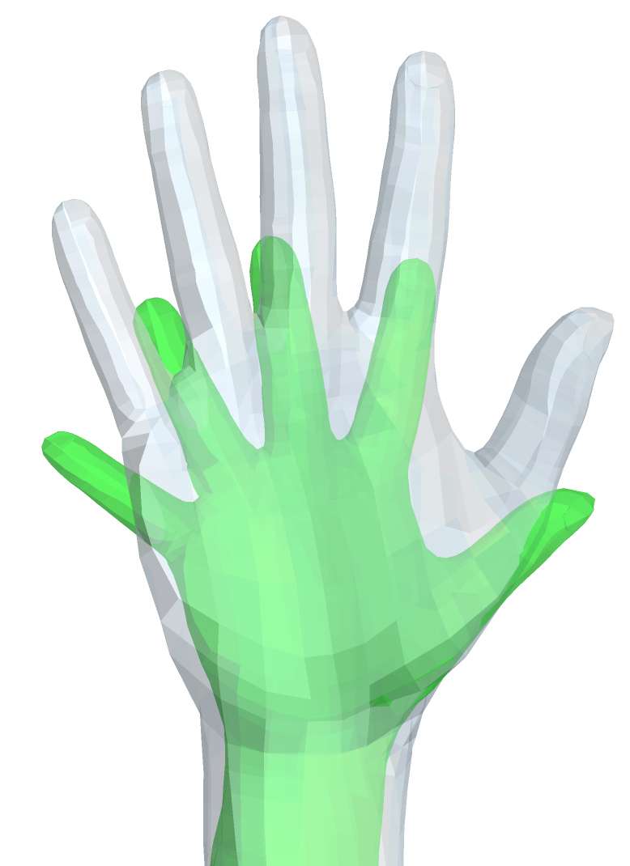
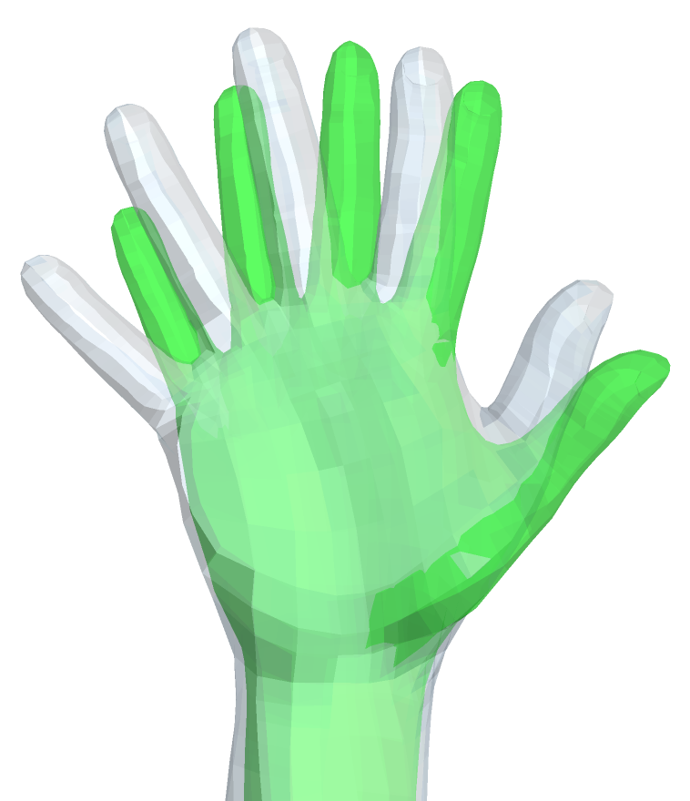
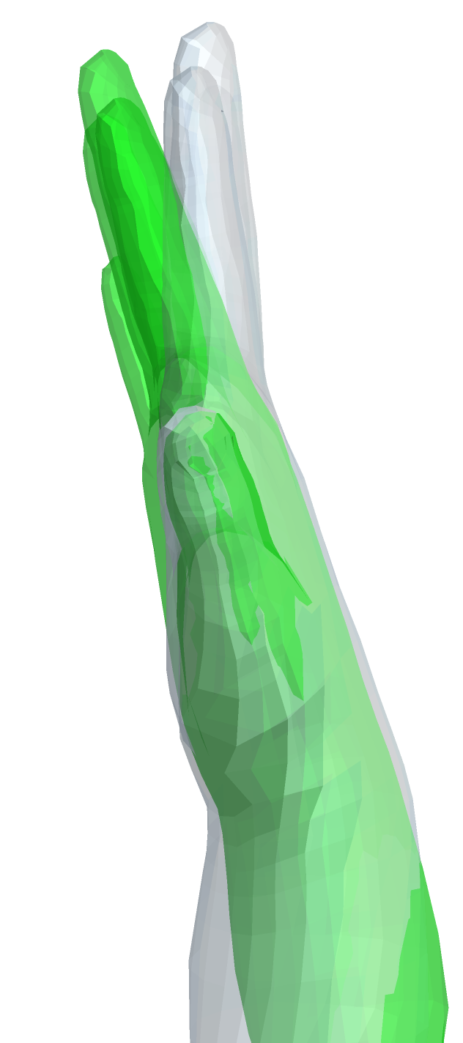
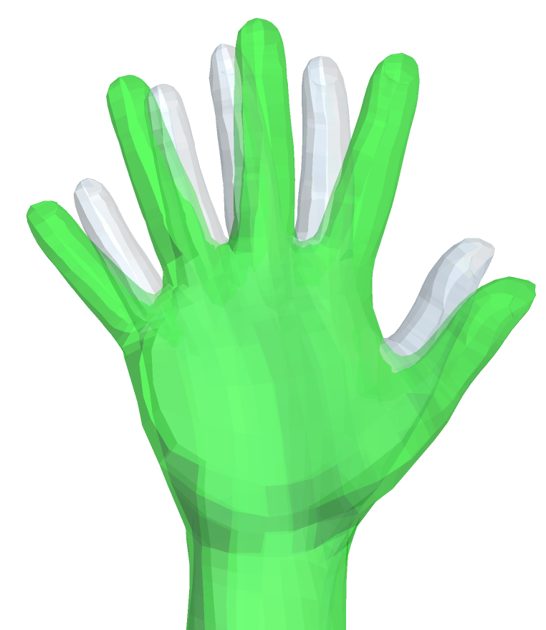
Principal Component Analysis
PCA was applied using methods developed in previous UMTRI studies
PCA reveals the primary modes of variance in the underlying data
Most variance is due to size and pose variability
PC1
PC2
PC3
PC4
Images show ±3 SD

Slide 11
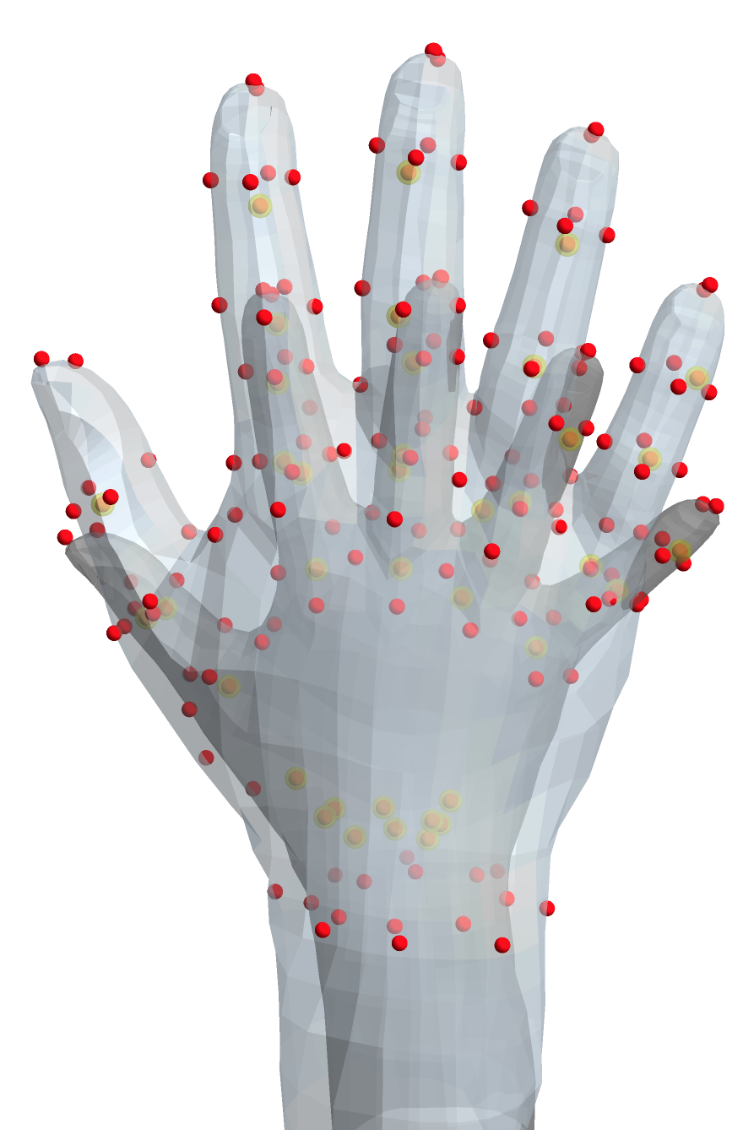
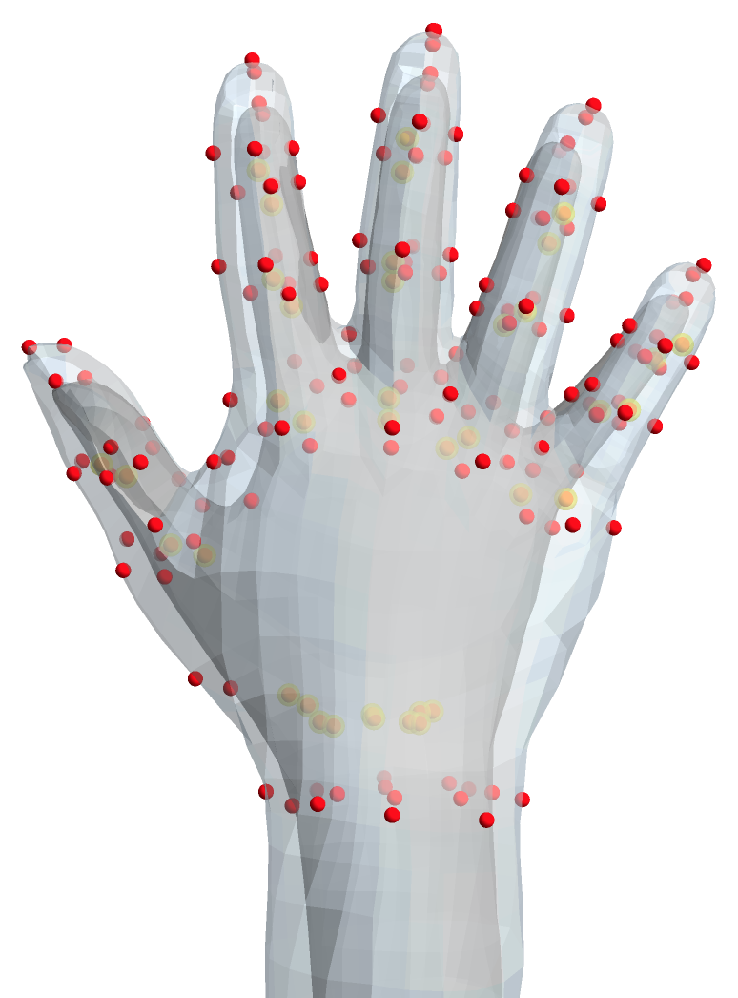
Regression
A regression model was developed to predict hand geometry as a function of hand length and width (many other variables could be used)
Input: smallest and largest hand width & hand length
Input: mean length and narrow and wide width

Slide 12
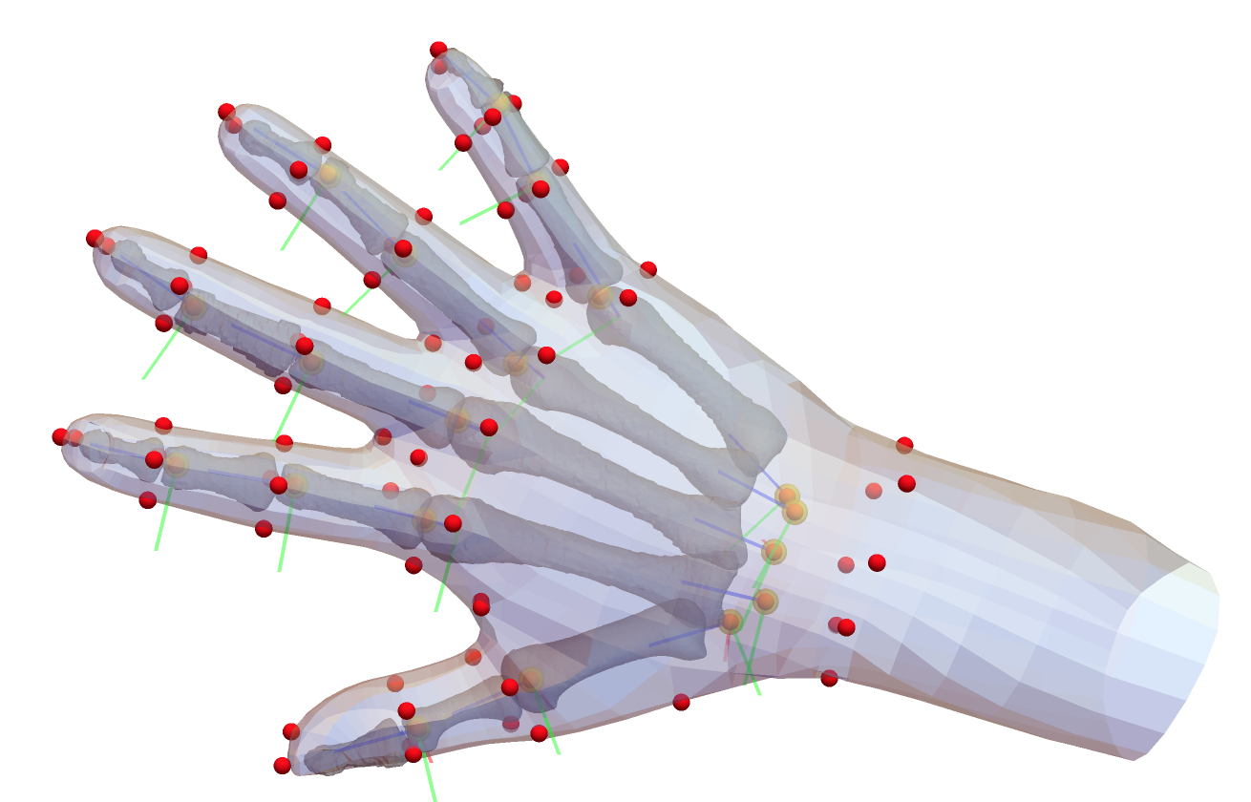
Adding Bones
Local bone coordinate systems are calculated from the joints and landmarks that are generated from the regression model
The bones are generated from the 19 individual regression models using each segment length as input

Slide 13
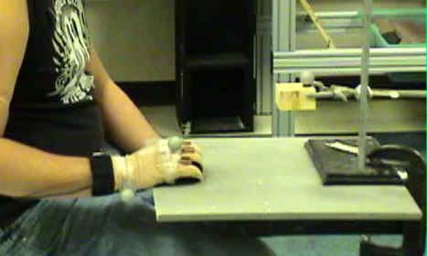
Hand Pose Motion Model
In previous work in the Humosim lab, we created a detailed model of hand pose motion.
The model includes five grasps, parameterized by aperture, and five hand postures for pushing against objects (index finger, four-finger press, fist, thumb press)
The model was implemented in the Human Motion Simulation Framework in Jack
Example of data gathering with CyberGlove

Slide 14
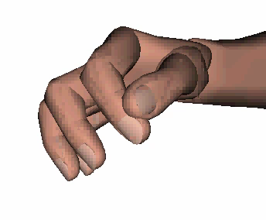
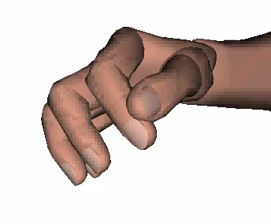
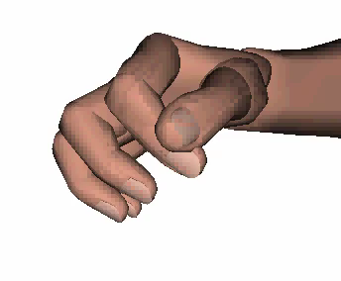
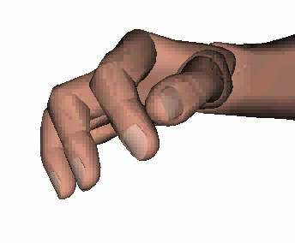
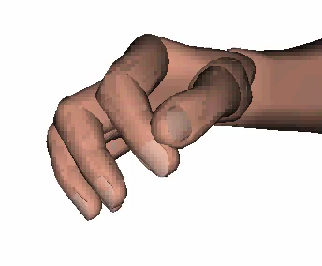
Simulated Grasp Motions
Two-Finger Pinch
Precision Pinch
Power Grasp
Lateral Pinch
Chuck Pinch

Slide 15
Next Steps
• Address some remaining anomalies in landmark and joint locations
• Integrate all 300 landmarked scans (current model from 147)
• Verify bone segment length predictions and bone locations using CT data
• Verify hand dimension predictions
• Map Humosim hand pose motion model to new geometry
• Add blending functions to support articulation (pose transition)
• Implementations
• Biomechanics: add tendons and joint motion constraints

Slide 16
Applications
• Glove sizing & fit
• PPE simulation (e.g., burns)
• General DHM ergo applications
• Model-based hand tracking for ergo/biomech studies
• Hand biomechanics
• Acute hand injury prediction

