Slide 1
Updates: Head Under Hair
Biosciences Group
Feb. 21, 2018

Slide 2
Template Fit Procedure
Digitize facial and head landmarks
Align head scans based on digitized landmarks
Morph template model to match landmarks using RBF
Fit morphed template model to target scan
Symmetrize fitted template with landmarks
Notes:
high

Slide 3
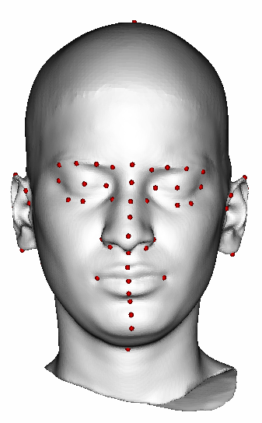
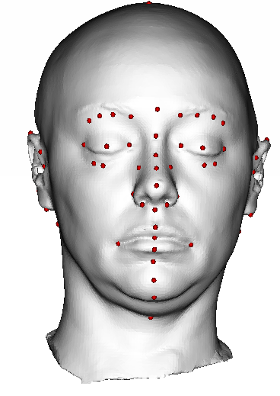
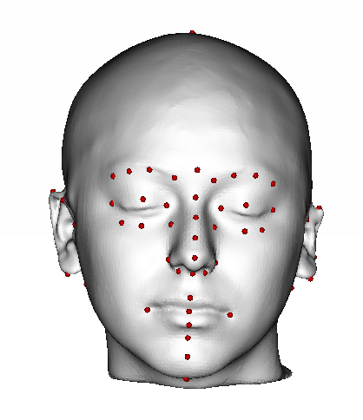
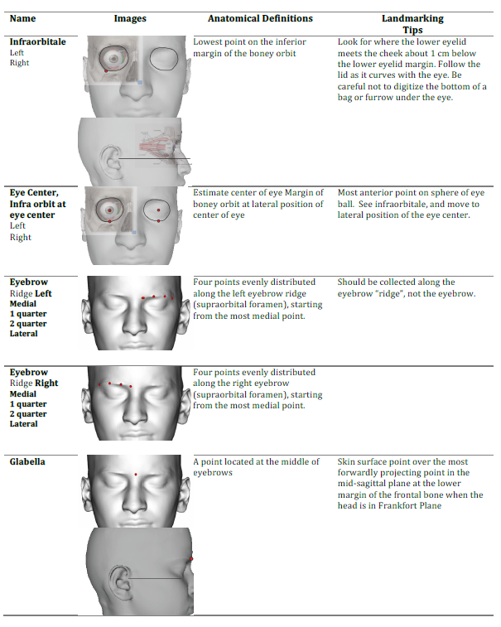
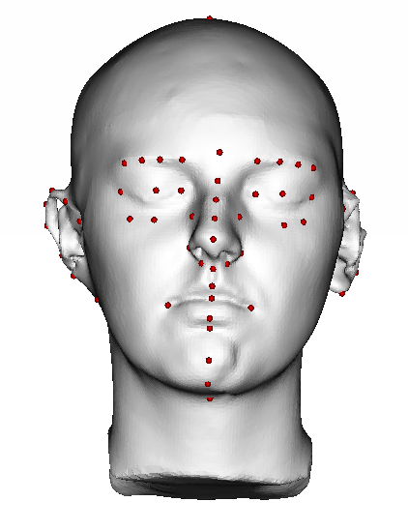
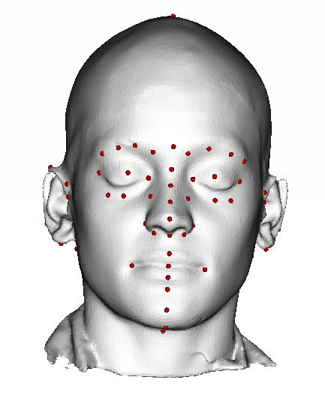
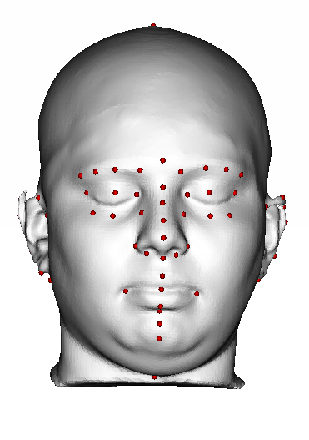
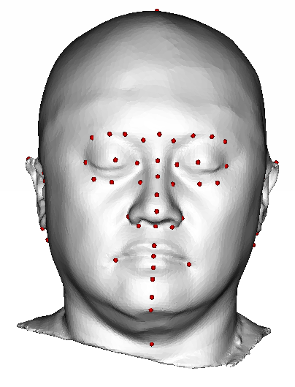
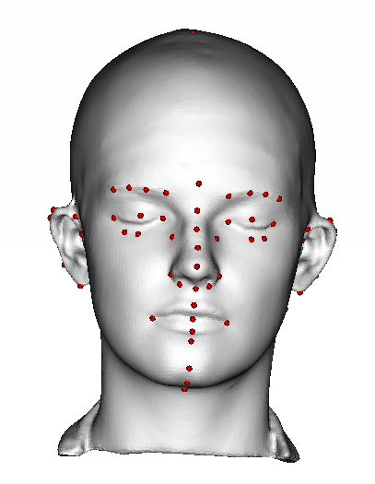
Digitize Landmark Data
Head landmark definition

Slide 4
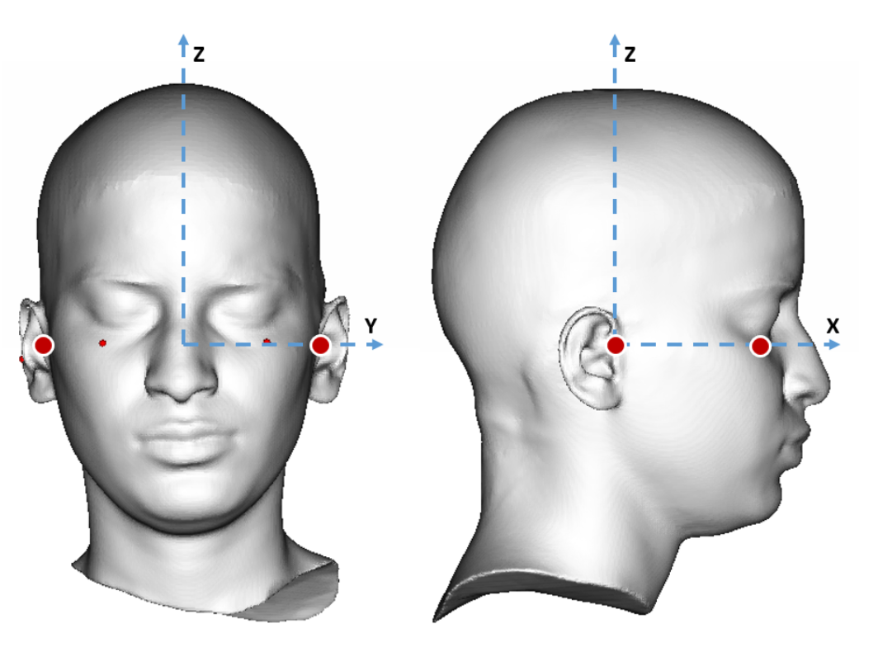
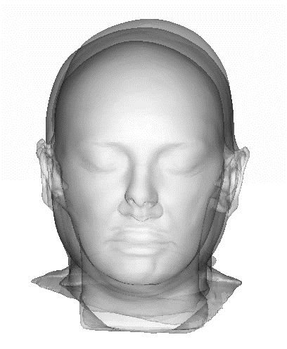
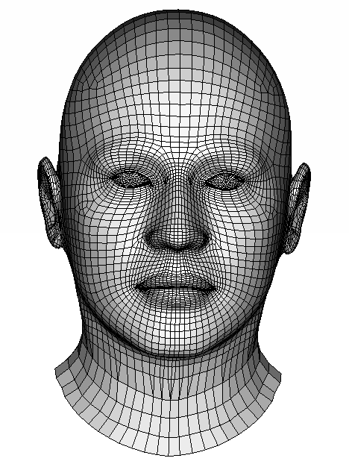
Template Head Model and Coordinate System
Head mesh was extracted from the BioHuman model
All scans were aligned to have the identical coordinate system
Head template
5487 Vertices
Head coordinate system
Originated at the mid-tragion
Aligned head scans
Notes:
Important for consistently collecting the landmarks since some lms are sensitive to the orientation of the head. E.g., top of head can be located at different places according to the orientation.

Slide 5
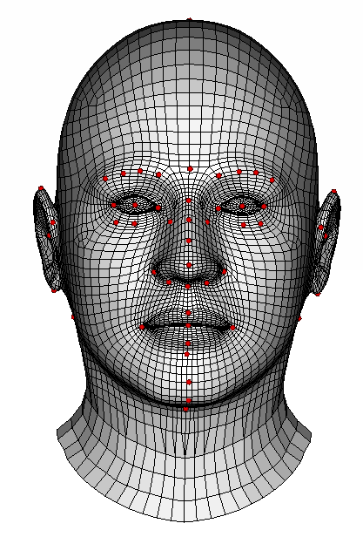
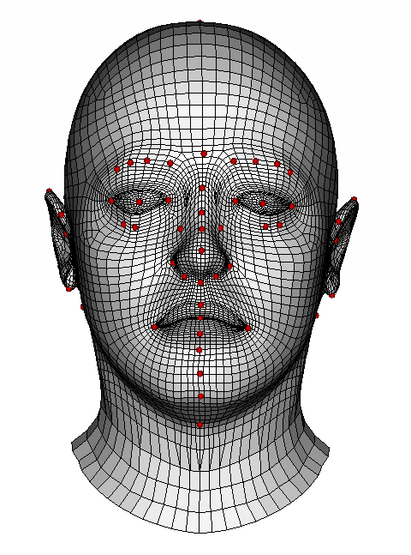
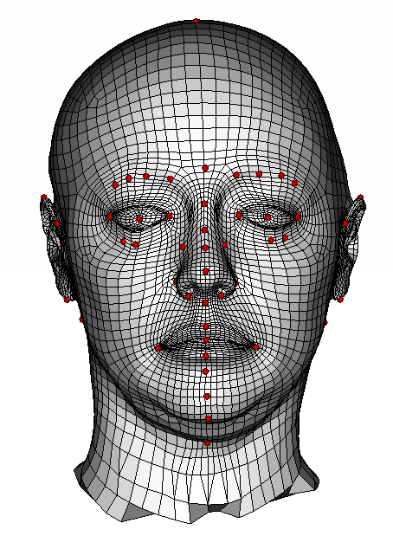
Fit Template to Scan
Target Scan
Head template
5487 Vertices
Initial morphing
to match landmarks
Fine morphing
to match entire shape
Notes:
Two step

Slide 6
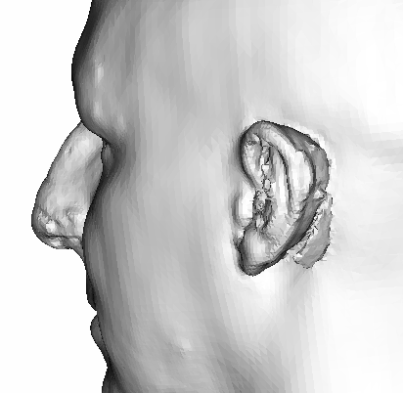
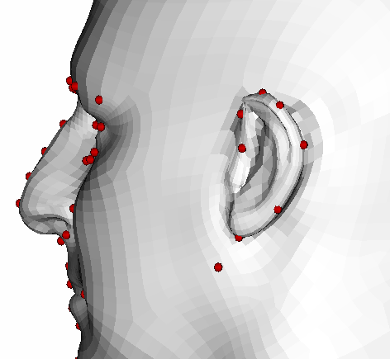
Ear Replacement
Ear geometries were replaced with template ears scaled/morphed based on landmarks
Notes:
Scan artifacts
Extracted ear geom from template, and morphed
pinna

Slide 7
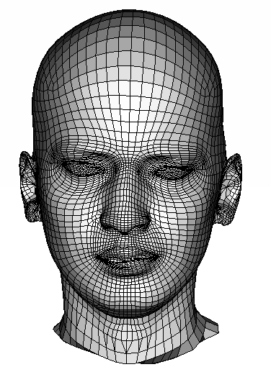
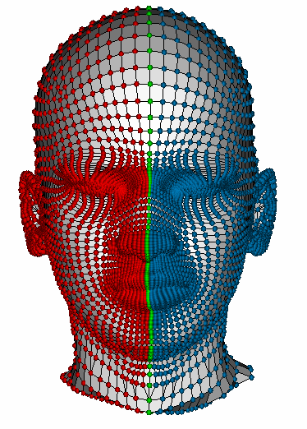
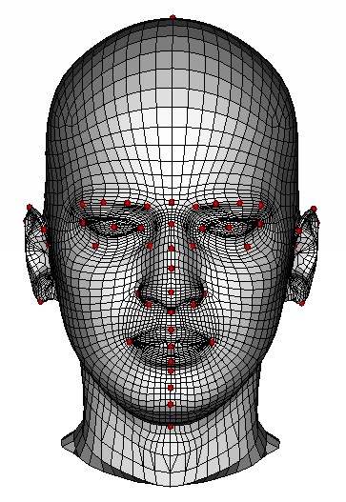
Symmetrization
Symmetrize fitted meshes by averaging left and right vertex pairs
Fitted template
Predefined vertex pairs
Right (red), left (blue) and center (green)
Symmetrized fit
With symmetrized landmarks

Slide 8
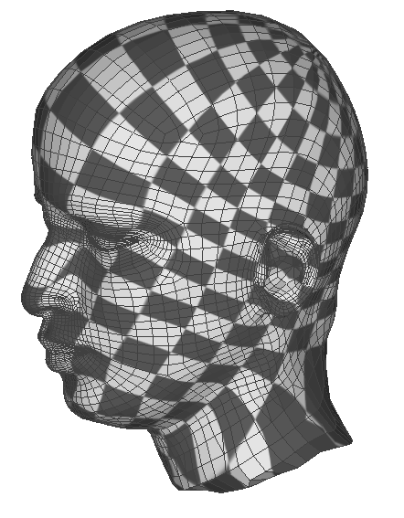
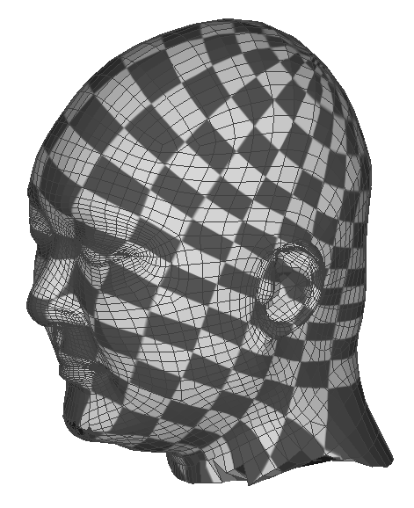
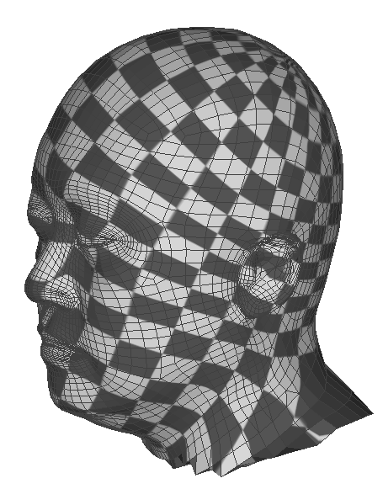
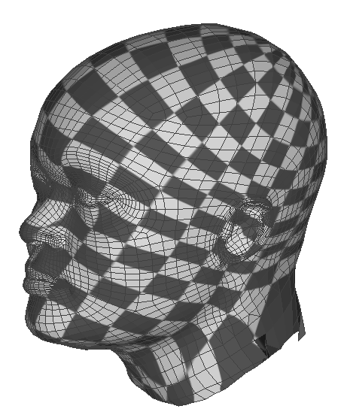
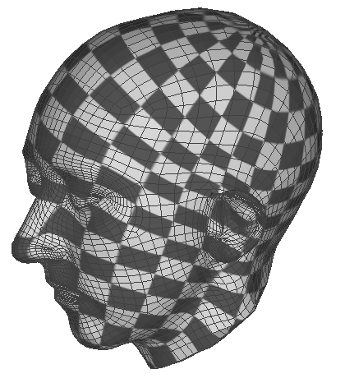
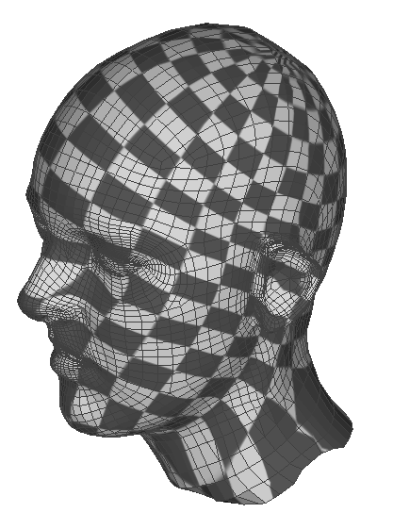
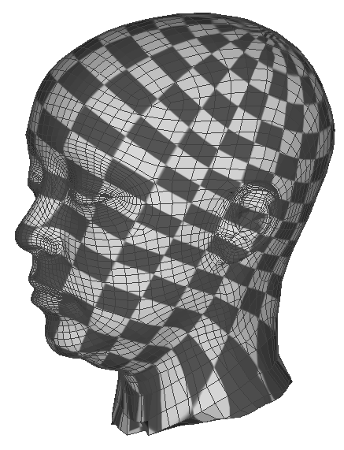
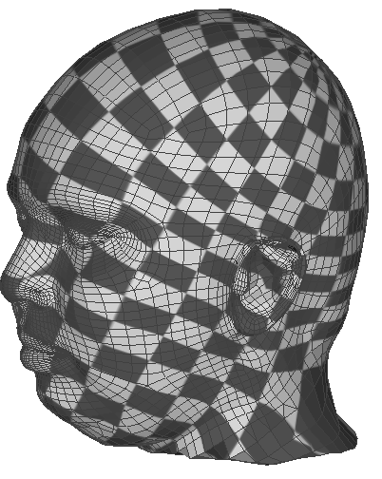
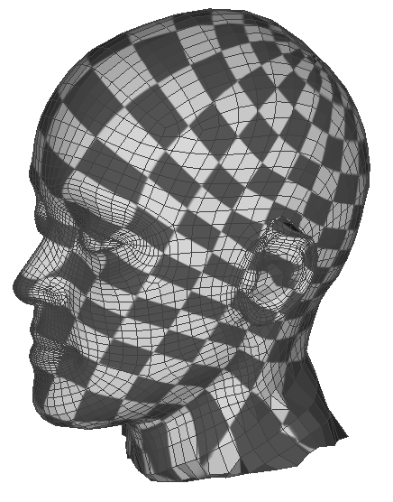
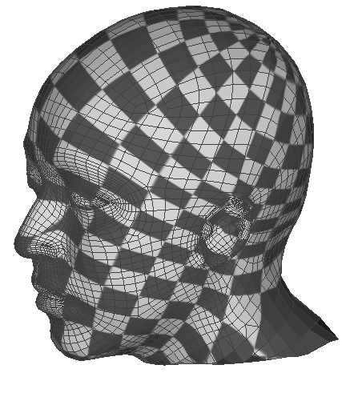
Template Fitting Results
Notes:
One of the important metric for successful template fitting is how homologous the …
Applied the same texture to all the fits to see how homologous the fitted meshes are.

Slide 9
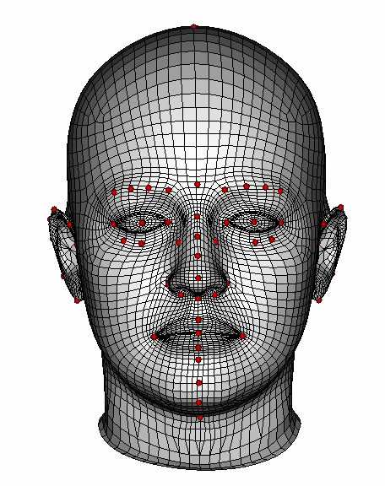
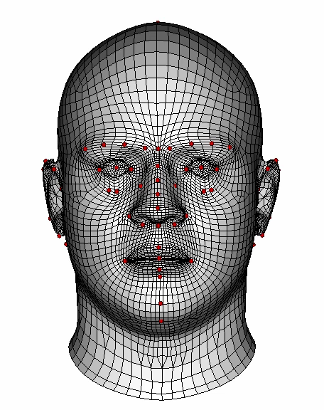
Result Comparison
Female Model: Good
Male Model: Not good

Slide 10
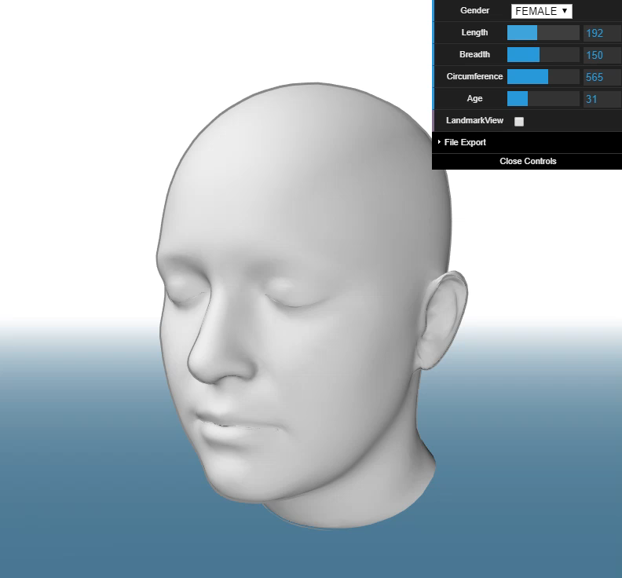
Statistical Head Model
Built regression model on PC scores with measured anthropometric data of
Gender
Head Length
Head Breadth
Head Circumference
http://AdultShape.org/head/

Slide 11
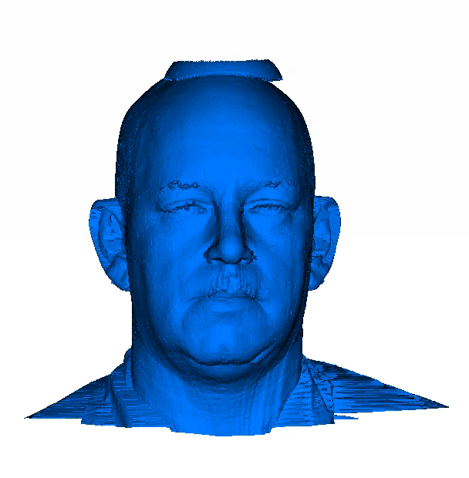
Application 1: Anthropometry Prediction
By fitting the model to an incomplete scan data, anthropometric variables including landmarks inherent in the model can be efficiently predicted

Slide 12
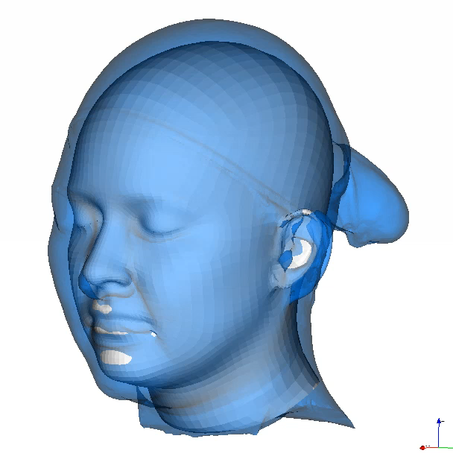
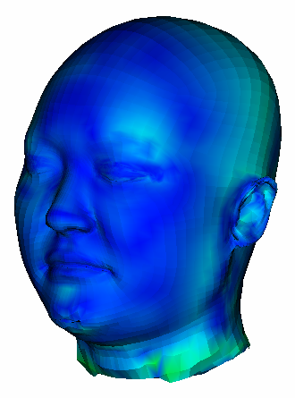
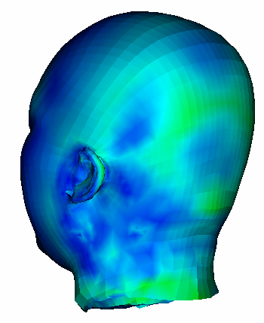
Application: Head Under Hair Estimation
Fit face and neck parts to estimate scalp shape
Err.
in mm
10
5
0

Slide 13
Conclusion
58 landmarks were carefully digitized for head scans (landmarks for the male scans will be fixed)
Template model was fit to the scans and symmetrized
Model can predict head shape from hair-contaminated scans (i.e. nearly all scans)
Future works:
  add in another 100+ scans with a wide range of race/ethnicity, BMI, & age
  develop an API for using the model

Slide 14
Thank you
Contact
B-K Daniel Park, PhD (keonpark@umich.edu)
Mathew P. Reed (mreed@umihc.edu)

Slide 15
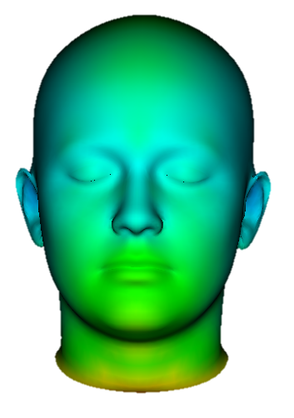
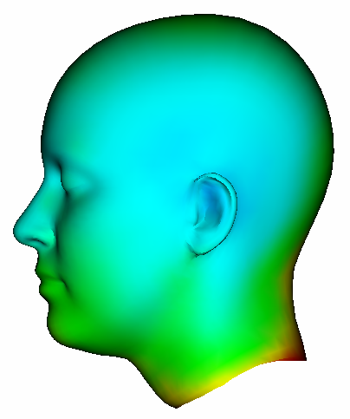
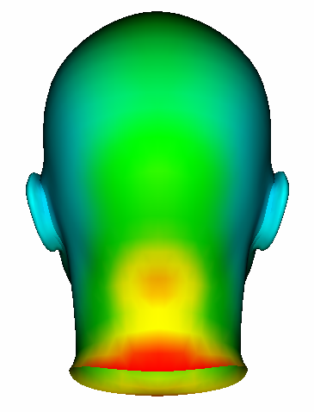
Standard Deviation Per Vertex
SD varies 1.5 mm ~ 11.5 mm
SD
in mm
10
5
0

