Slide 1
UMTRI Human Body Model Overview
UMTRI Biosciences
February 21, 2018

Slide 2
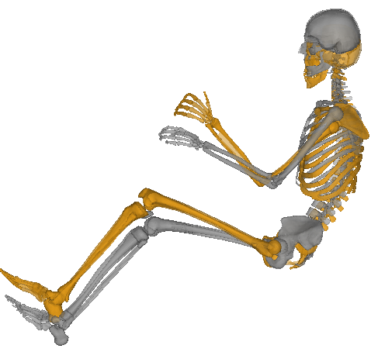
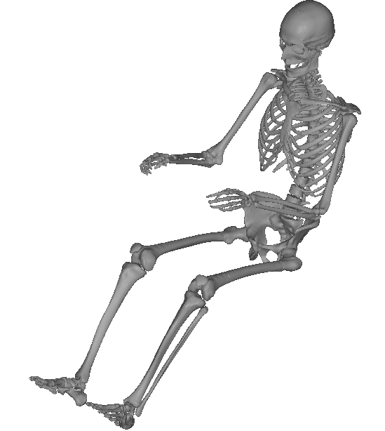
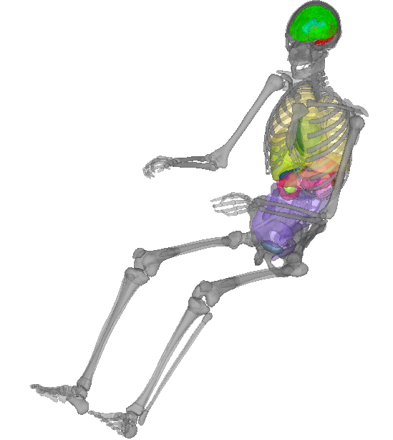
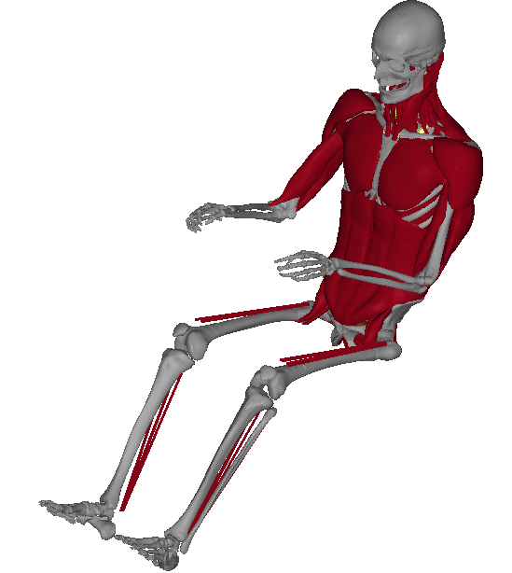
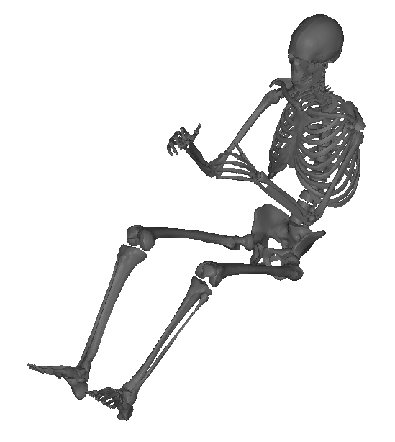
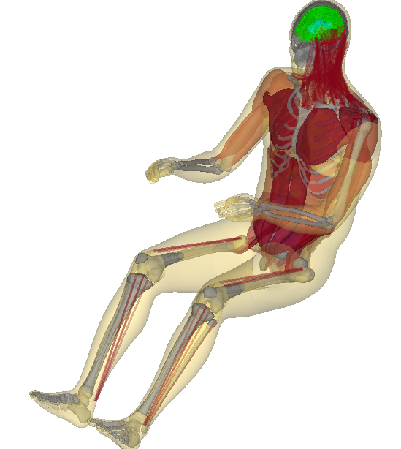
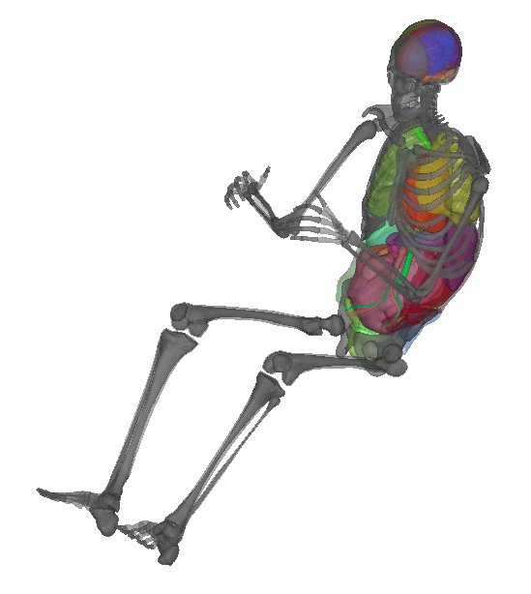
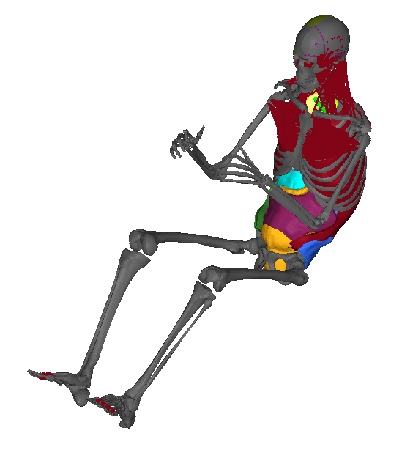
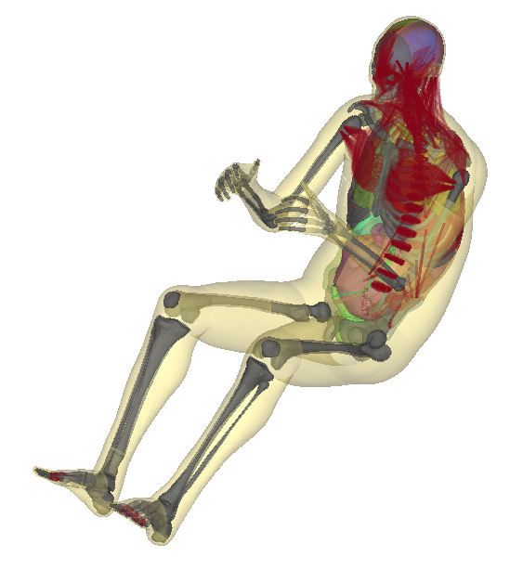
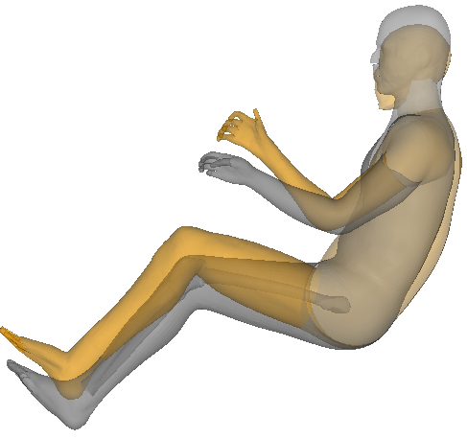
Finite Element Human Models
Total Human Model for Safety (THUMS)
Mid-size Male
Global Human Body Modeling Consortium (GHBMC)
Mid-size Male
Skeleton Overlay
GHBMC
Body Shape Overlay
THUMS

Slide 3
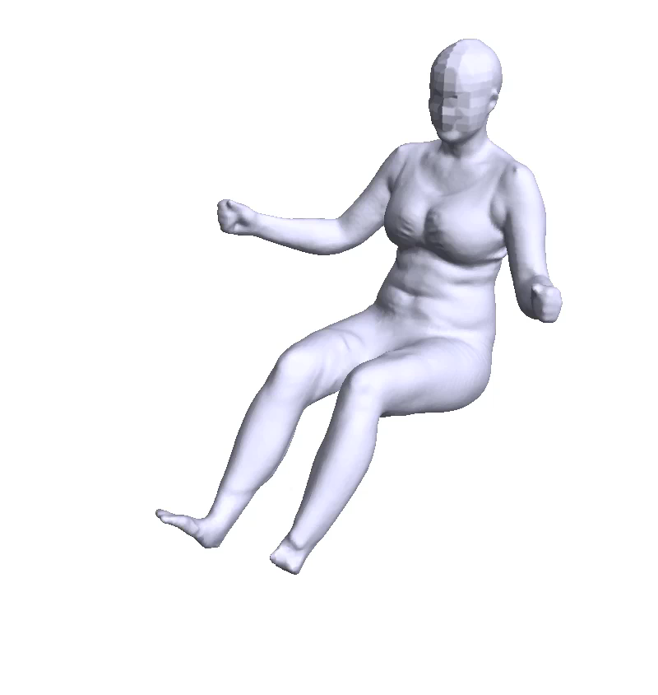
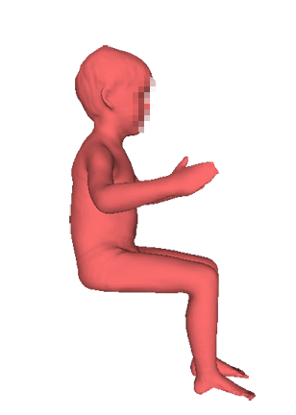
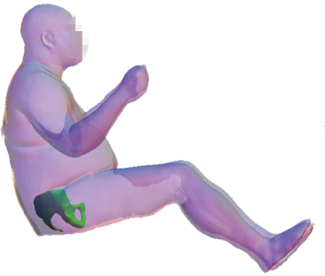
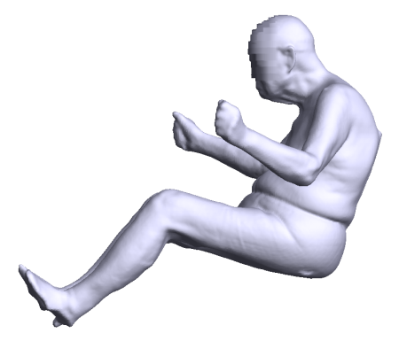
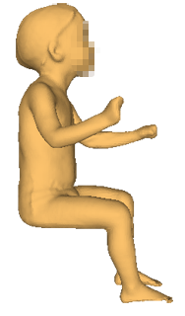
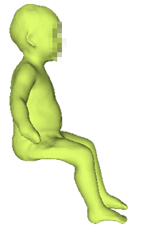
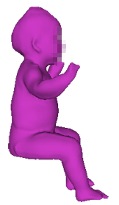
Finite Element Human Models
Total Human Model for Safety (THUMS)
Mid-size Male
Global Human Body Modeling Consortium (GHBMC)
Mid-size Male
Body Scan Data
Small
Obese
Old
Vulnerable Populations

Slide 4
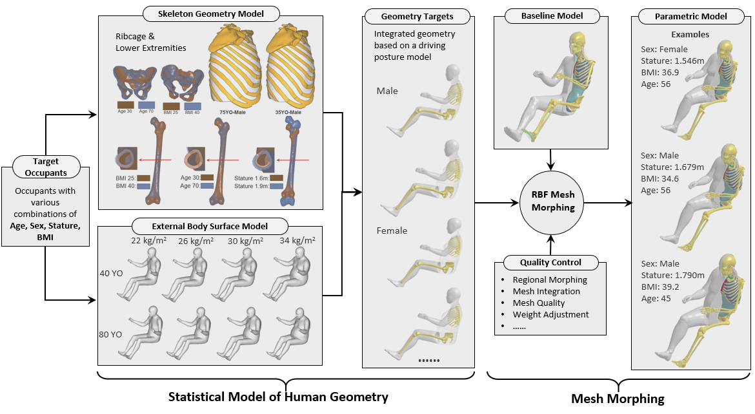
UMTRI Parametric Whole-body Human Model
Shi et al. (2015) CMBBE
Hu et al. (2016) DHM
Hwang et al. (2016) SAE&Stapp
Zhang et al. (2017) JBiomech
Funded by NHTSA, Toyota, NSF and GM

Slide 5
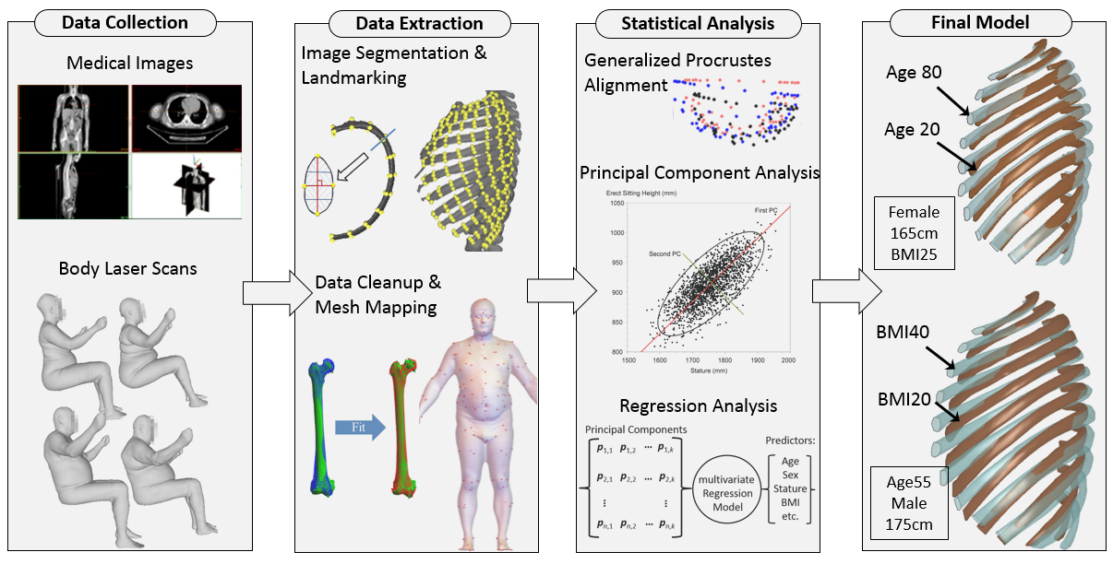
Statistical Geometry Model

Slide 6
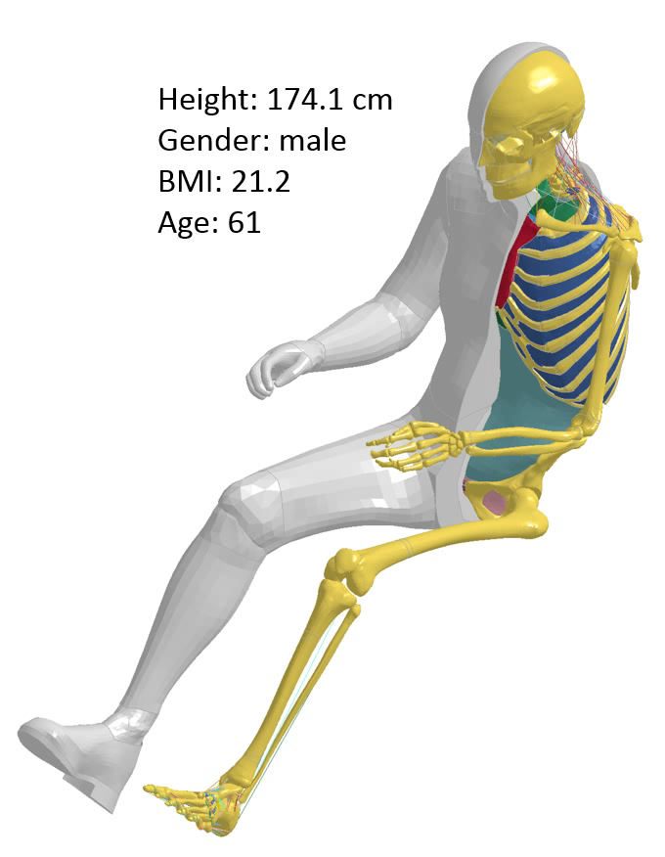
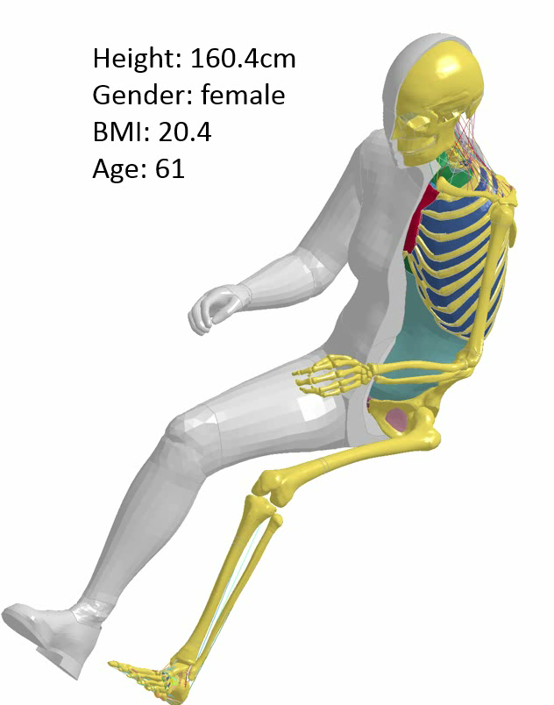
Morphed Human Body Models
Hundreds of FE human body models can be generated rapidly
Female
Male

Slide 7
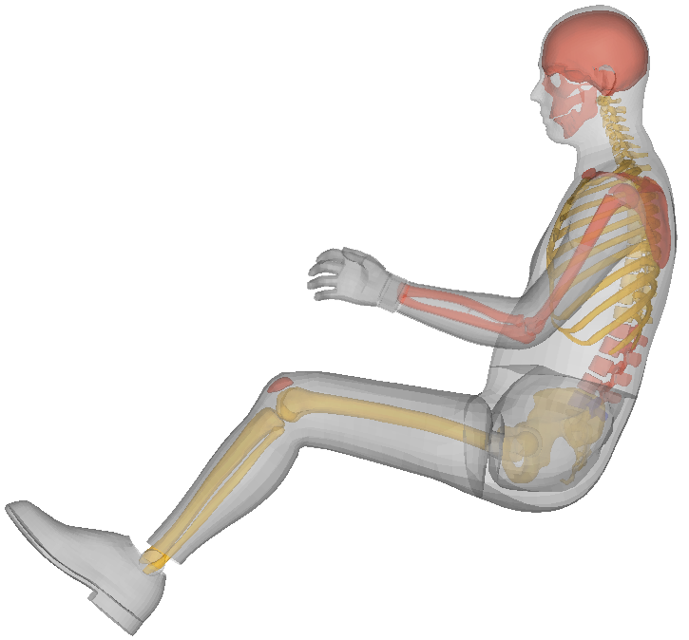
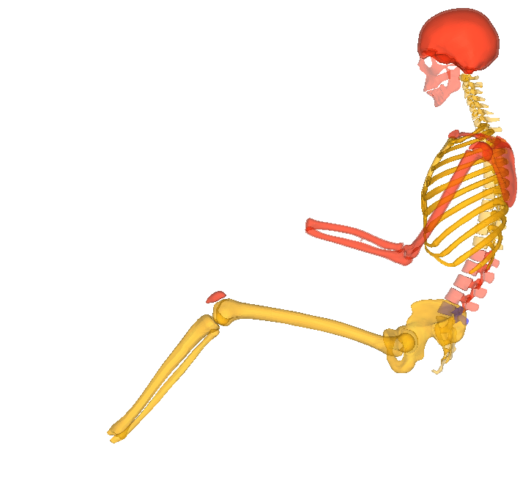
UMTRI Model Geometry Targets
Body Region | Sex | Subject Number | Reference
External Surface | F | ~100 | (Reed and Parkinson 2008)
 | M | ~100
Pelvis | F | 77 | (Klein 2015)
 | M | 39
Femur | F | 36 | (Klein et al. 2015)
 | M | 62
Tibia | F | 28 | (Klein 2015)
 | M | 48
Ribcage | F | 47 | (Wang et al. 2016)
 | M | 54
C-Spine | F | 79 | (Reed and Jones 2017)
 | M | 61
Statistical Prediction
Single subject
External surface model was recently updated at humanshape.org
Head shape was updated based on bold heads
Hands and feet/shoes were from HIII ATD
Sex: Male
Age: 26 YO
Stature: 1.756m
Weight: 78 kg

Slide 8
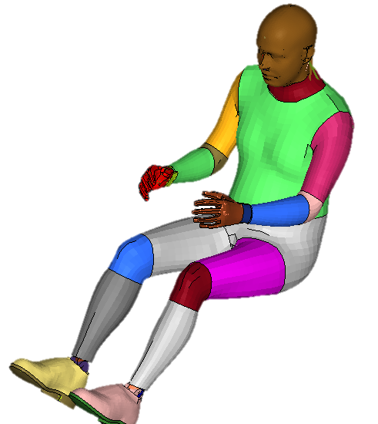
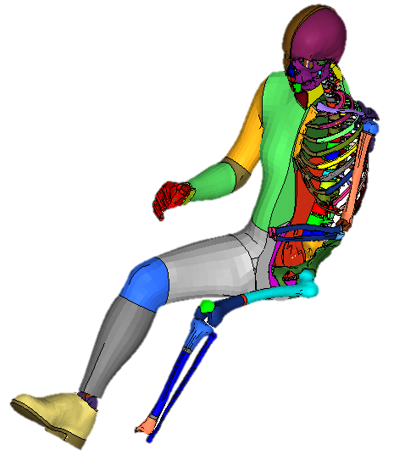
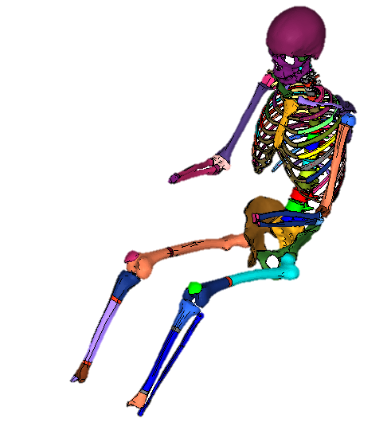
Meshing
Whole-body

Slide 9
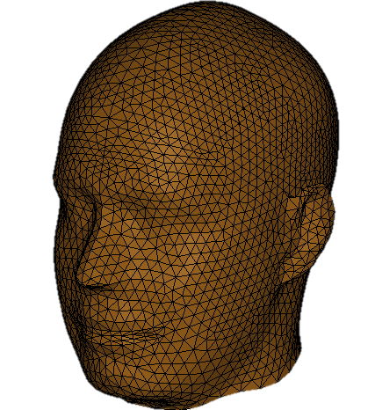
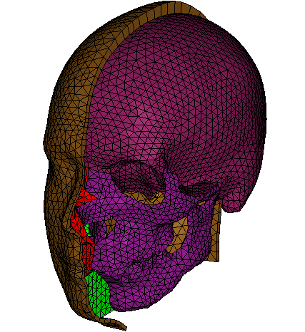
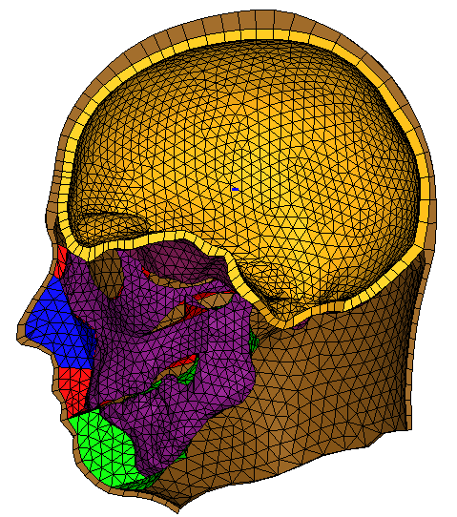
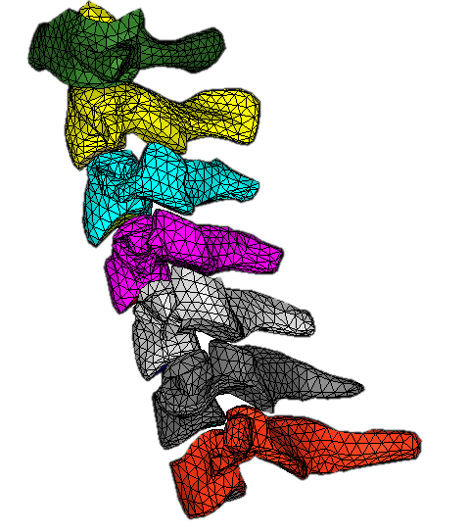
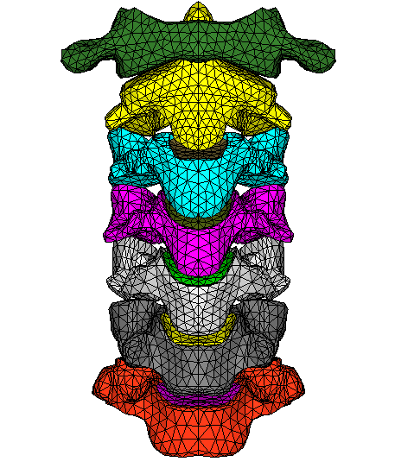
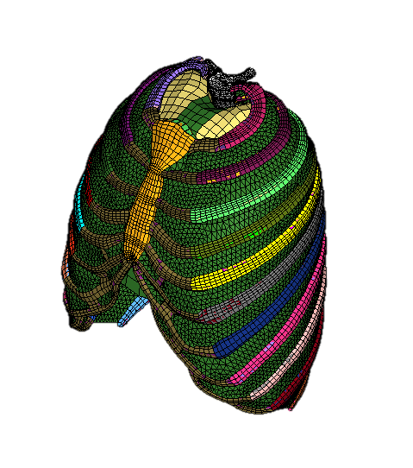
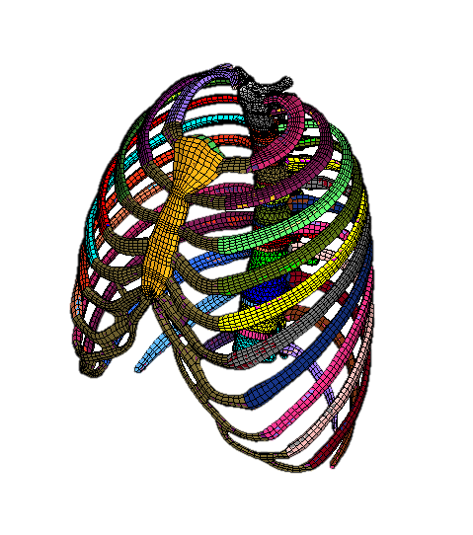
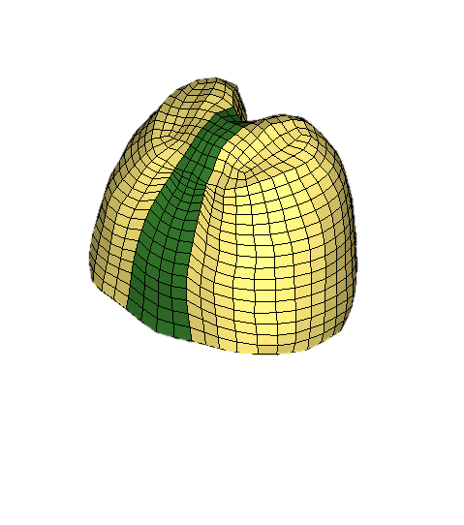
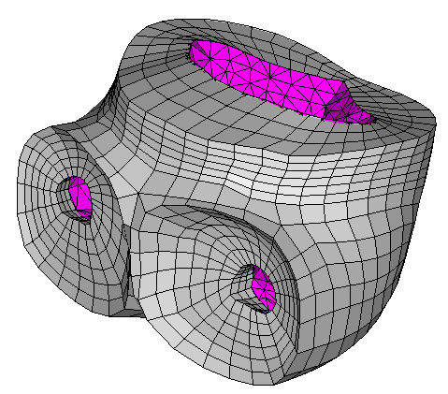
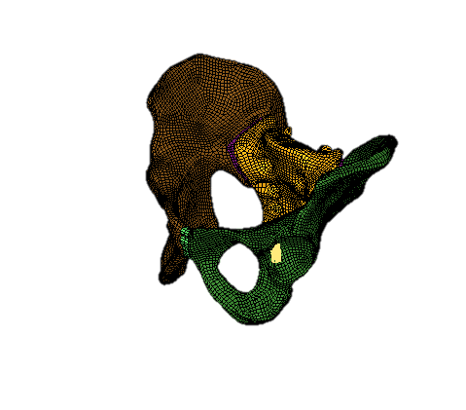
Meshing
Head
Neck
Thorax
Pelvis

Slide 10
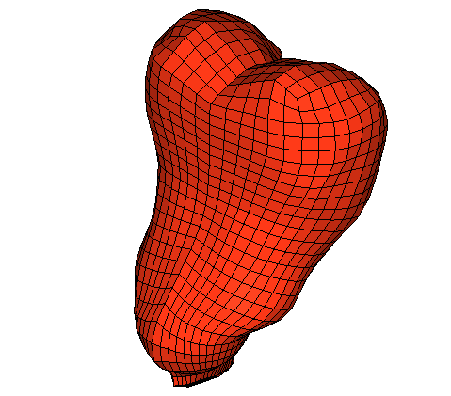
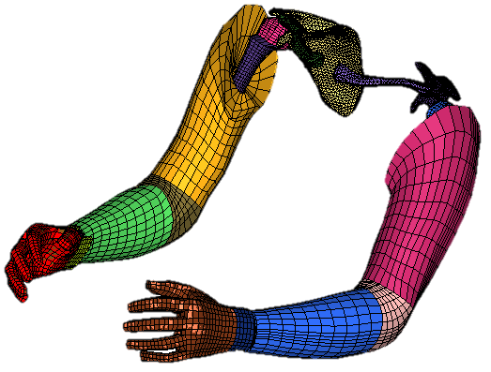
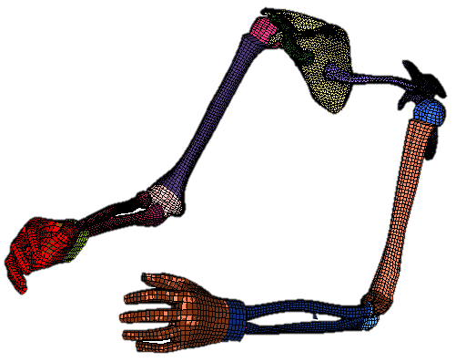
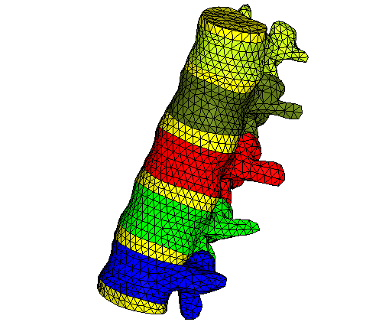
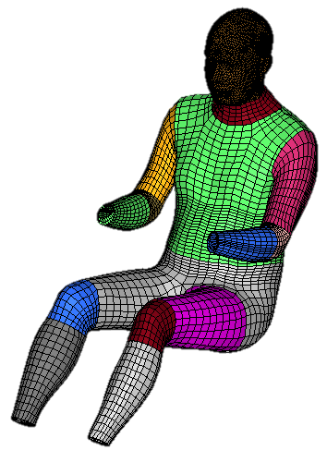
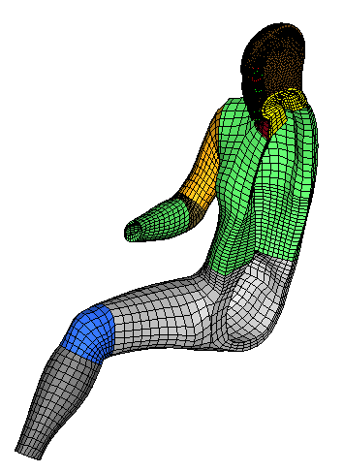
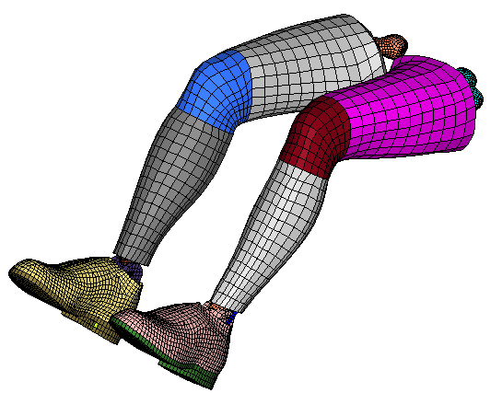
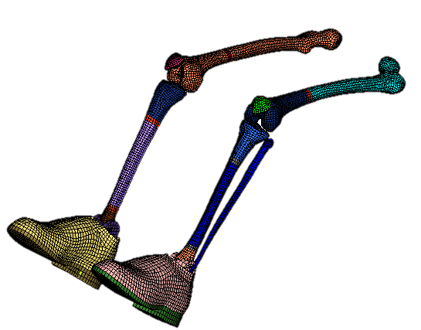
Meshing
Lumbar & Abdomen
Upper Extremities
Lower Extremities
Flesh

Slide 11
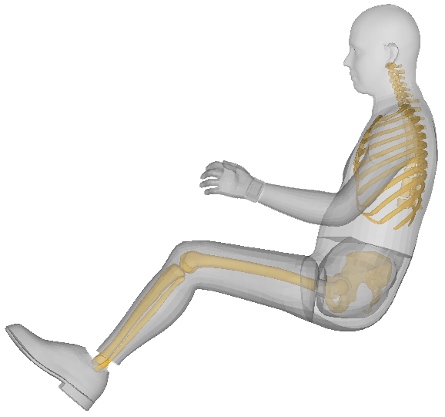
Mesh Morphing Process
Radial Basis Function
  Sequential mesh morphing
  Component by component
Controlled geometries
Skeleton
  Statistical prediction: ribcage, pelvis, femur, tibia, c-spine
  Morphing: all the other bones
External body shape
  Mesh mapping between statistical body shape geometry and the newly developed body surface mesh
  Head, hands, and feet/shoes are in different geometries

Slide 12
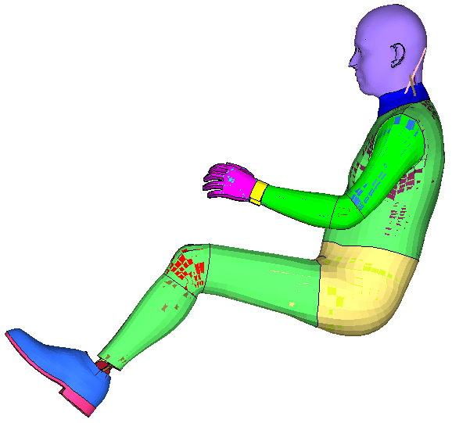
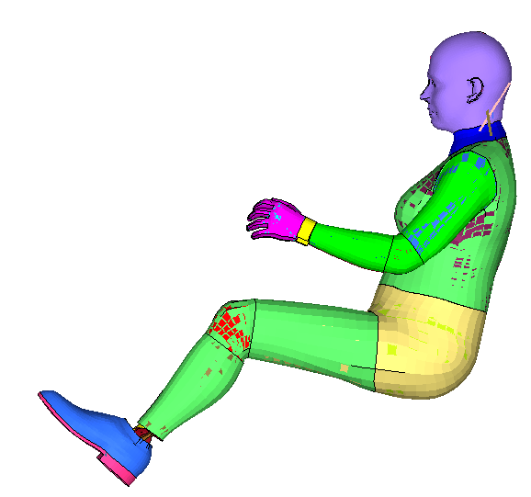
Mesh Morphing Example
Sex: Male
Age: 26 YO
Stature: 1.756m
Weight: 78 kg
Sex: Female
Age: 26 YO
Stature: 1.619m
Weight: 72.6 kg
Element Type | Jacobian Criteria | Total Elements | Failed Elements
2-d | >=0.35 | 146,544 | 43
3-d | >=0.3 | 68,232 | 28
Element Type | Jacobian Criteria | Total Elements | Failed Elements
2-d | >=0.35 | 146,544 | 44
3-d | >=0.3 | 68,232 | 256

Slide 13
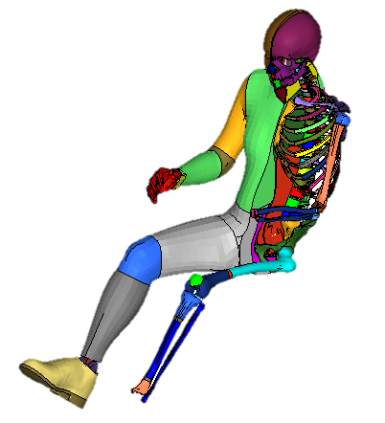
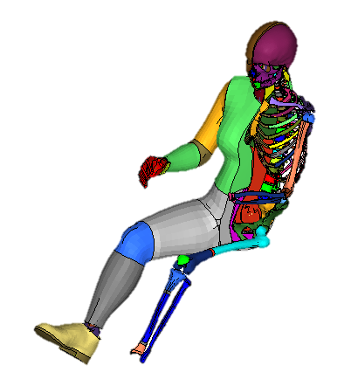
Mesh Morphing Example
Sex: Male
Age: 26 YO
Stature: 1.756m
Weight: 78 kg
Sex: Female
Age: 26 YO
Stature: 1.619m
Weight: 72.6 kg
Element Type | Jacobian Criteria | Total Elements | Failed Elements
2-d | >=0.35 | 146,544 | 43
3-d | >=0.3 | 68,232 | 28
Element Type | Jacobian Criteria | Total Elements | Failed Elements
2-d | >=0.35 | 146,544 | 44
3-d | >=0.3 | 68,232 | 256

Slide 14
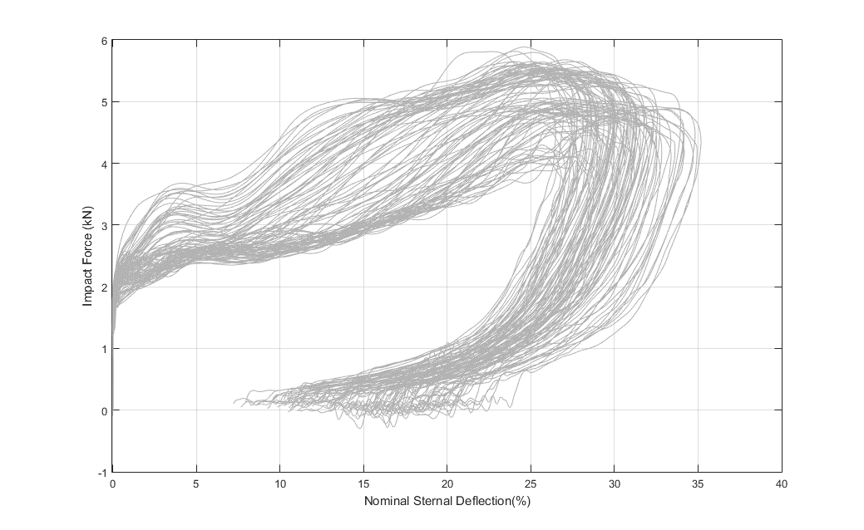

Pendulum Impact Simulations

Slide 15

NCAP Simulation Examples

Slide 16
Simulated Trends in Injury Risks
Head
Chest
Chest
Knee-Thigh-Hip

Slide 17


Parametric Simulations and Optimization

Slide 18

Thanks!
Contact: Jingwen Hu, PhD
jwhu@umich.edu

